Slide 1
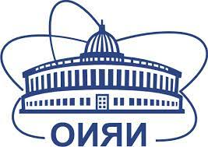
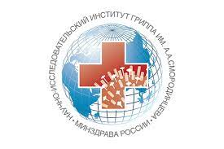

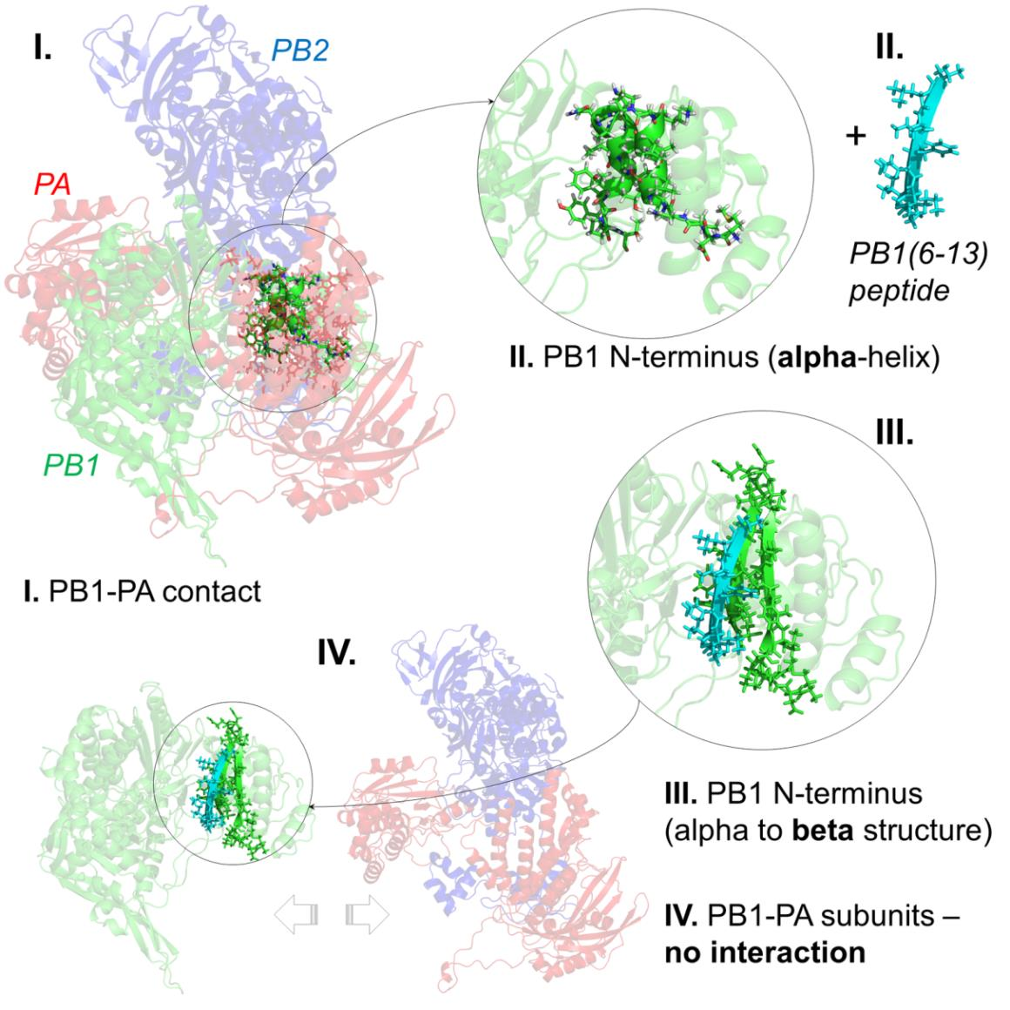
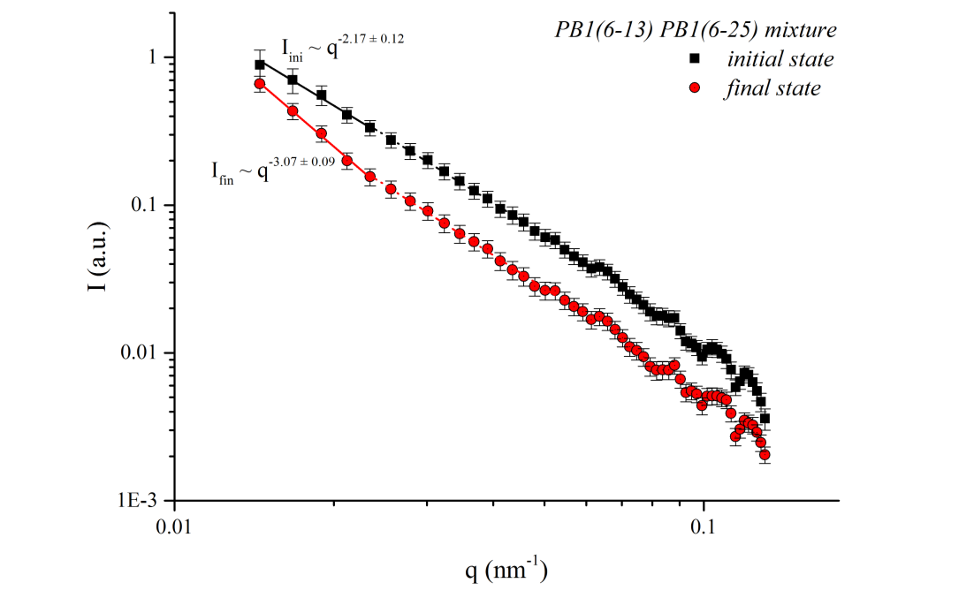
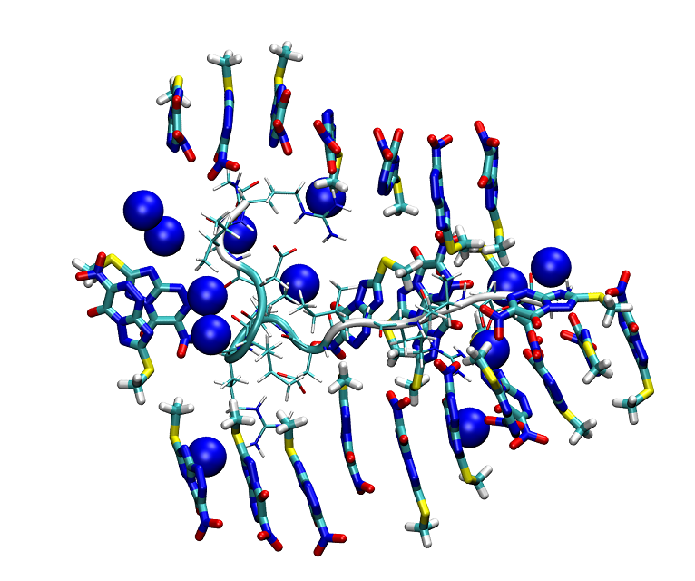
Mechanisms of action for the supramolecular drugs: neutron study
Yana Zabrodskaya, Alexey Shvetsov, Dmitry Lebedev, Yulia Gorshkova, Alexander Kuklin, Vitaly Pipich, Vladimir Isaev-Ivanov, and Vladimir Egorov
2. Supramolecular amyloid-like peptide complexes are capable of specific effects on the secondary structure of the protein, which can be used to create a new class of antiviral drugs, as was shown using small-angle neutron scattering and time-resolved x-ray scattering [4]–[6].
Interactions between SI and TZV
supramolecular complexes: MD simulation
1. Low molecular weight compounds Many low molecular weight compounds and peptides are capable of forming supramolecular complexes. In the form of such complexes, the molecules are capable of multicenter cooperative binding to target proteins. It is advisable to study these complexes using small-angle scattering methods in combination with molecular dynamics modeling in the free diffusion approach.
When studying the mechanism of interaction of a triazavirin drug with polypeptides by neutron small angle scattering methods in combination with molecular dynamics, it was shown that the drug molecules are capable of forming linear supramolecular complexes and altering the quaternary structure of proteins [1]–[3].
The PB1(6-13) and PB1(6-25) peptide mixture system initial (t = 0) and final (t = ∞) states spectra, reconstructed on the basis of a change in the singular decomposition zero and first components fro TR-SAXS SVD analysis
Small-angle neutron scattering curves analysis results of (A) – SI fibrils; (B) – SI fibrils with triazavirine. Data fitted to (A) worm-like model with fibril radius of 1.40 ± 0.04 nm and Kuhn length of 12.0 ± 0.7 nm (χ2 = 0.83, solid green line in Panel A) and (B) linear combination of random coil model (dotted red line) and long cylinders with the radii of 4.66 ± 0.14 nm (dashed blue line), χ2 = 1.2, shown in solid green line in Panel B.
Some drugs act only in the form of supramolecular complexes that are in dynamic equilibrium
Existing of such complexes cannot be detected using traditional methods - chromatography or microscopy
Only methods of light scattering, neutron scattering and X-ray scattering can be used in determination of its mechanism of action
3. The interaction of supramolecular complexes formed in lipid membranes with receptors can be used to modulate cell signaling, including the creation of immunomodulating drugs that affect T cells. The effect of complexes on the chromatin structure can be used to create a new class of drugs - epigenetic regulators that affect gene expression [7].
[1] A. V. Shvetsov, Y. A. Zabrodskaya, P. A. Nekrasov, and V. V. Egorov, “Triazavirine supramolecular complexes as modifiers of the peptide oligomeric structure,” J. Biomol. Struct. Dyn., vol. 36, no. 10, pp. 2694–2698, 2018, doi: 10.1080/07391102.2017.1367329.
[2] Y. A. Zabrodskaya, A. V Shvetsov, V. B. Tsvetkov, and V. V Egorov, “A double-edged sword: supramolecular complexes of triazavirine display multicenter binding effects which influence aggregate formation,” J. Biomol. Struct. Dyn., pp. 1–19, Aug. 2018, doi: 10.1080/07391102.2018.1507837.
[3] V. V. Egorov, Y. A. Zabrodskaya, D. V. Lebedev, A. N. Gorshkov, and A. I. Kuklin, “Structural features of the ionic self-complementary amyloidogenic peptide,” J. Phys. Conf. Ser., vol. 848, no. 1, p. 012022, 2017, doi: 10.1088/1742-6596/848/1/012022.
[4] V. V. Egorov et al., “Structural features of the peptide homologous to 6-25 fragment of influenza A PB1 protein,” Int. J. Pept., vol. 2013, p. 370832, Jan. 2013, doi: 10.1155/2013/370832.
[5] Y. A. Zabrodskaya et al., “The amyloidogenicity of the influenza virus PB1-derived peptide sheds light on its antiviral activity,” Biophys. Chem., vol. 234, no. January, pp. 16–23, 2018, doi: 10.1016/j.bpc.2018.01.001.
[6] O. V Matusevich et al., “Synthesis and antiviral activity of PB1 component of the influenza A RNA polymerase peptide fragments.,” Antiviral Res., vol. 113, pp. 4–10, Jan. 2015, doi: 10.1016/j.antiviral.2014.10.015.
[7] D. V. Lebedev et al., “Effect of alpha-lactalbumin and lactoferrin oleic acid complexes on chromatin structural organization,” Biochem. Biophys. Res. Commun., vol. 520, no. 1, pp. 136–139, 2019, doi: 10.1016/j.bbrc.2019.09.116.

