Slide 1
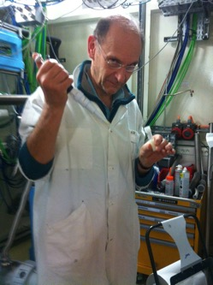
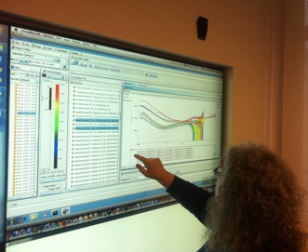








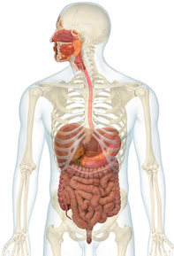
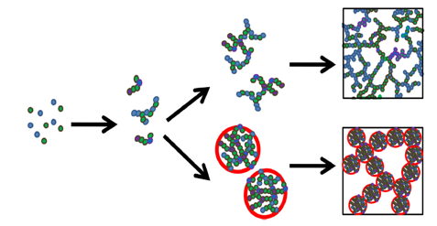


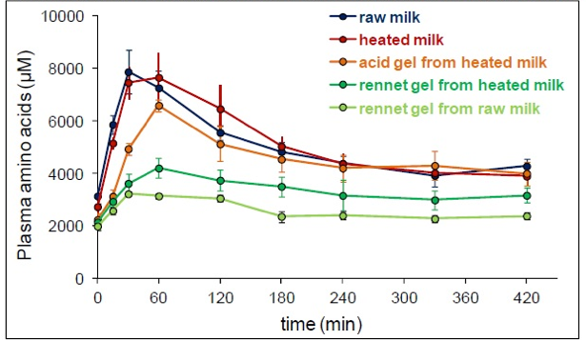
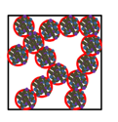



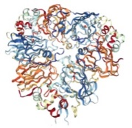
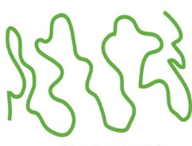
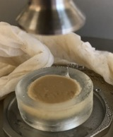
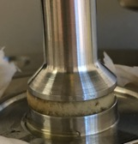
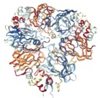

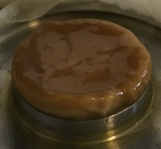
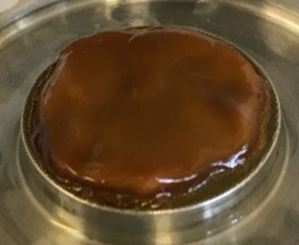
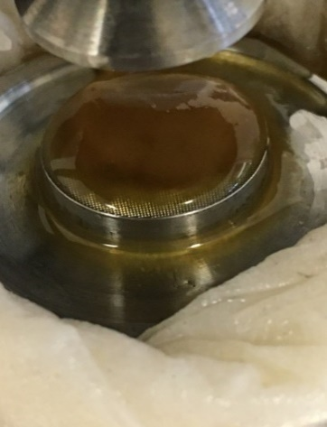
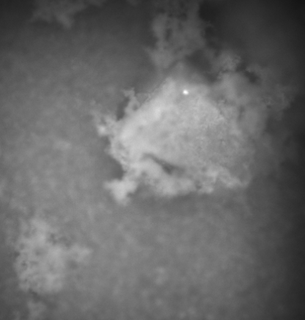
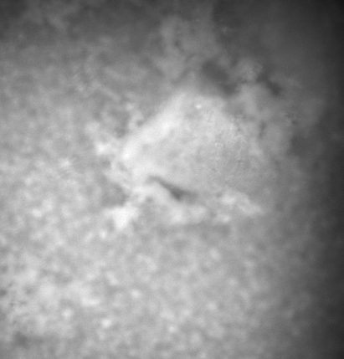
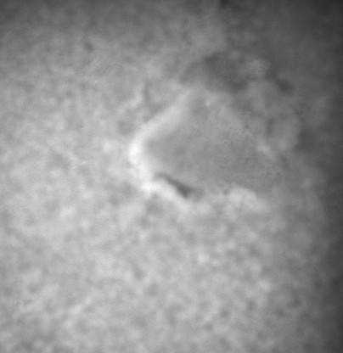
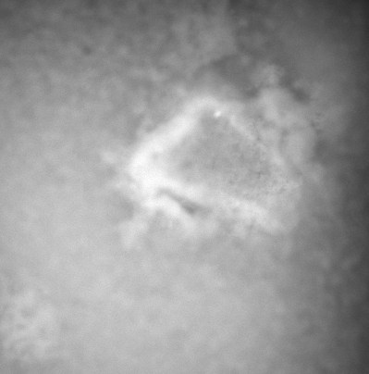
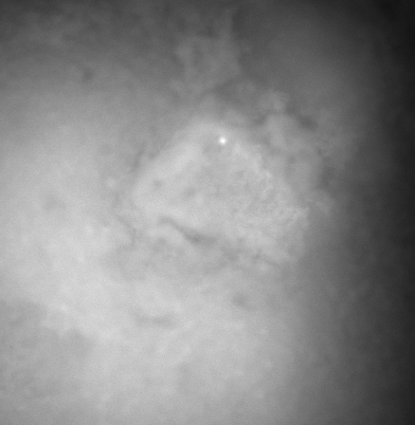
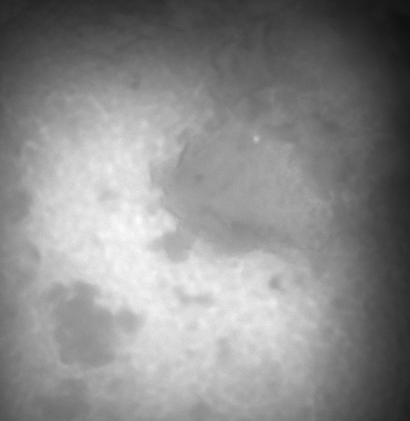
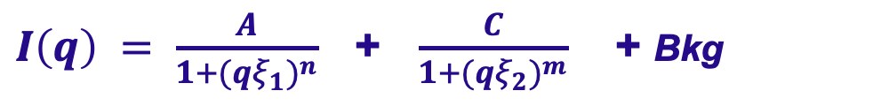
Monitoring in vitro human digestion of model food, a plant protein gel, using SANS
F. Boué, Maja Napieraj, A. Brûlet (Lab Léon Brillouin)
E. Lutton, A. Boire (INRAE-MIA Paris, BIA-Nantes)
F. Jamme , J. Perez, T. Bizien (SOLEIL)
M. Ströbl (Paul Scherrer Inst.,Suisse)
Aims
to monitor the effects of an acid/pepsin mixture (gastric juice), followed by neutral/pancreatin mixture (intestinal).
to see how different initial structures of plant gels are modified during gastric and intestinal digestion.
Digestion, a complex process
SANS: Gelation of protein solutions
1: multiplace, multitime, multiscale
Mouth Stomach Intestine Colon
Aggregation & gelation:
$I\left(q\right) = \frac{A}{1+{(qξ_{1})}^{n}}$ + $\frac{C}{1+{(qξ_{2})}^{m}}$ + Bkg
Multi-loci
pH 6
pH 7
High q
pH 1-2
q⁻ ⁴
Amylase
Pancreatin
Low q
Multi-processes
(pH, enzymes, flow)
Pepsin
Amylase
Microbiote
q⁻ ²
q~⁻ ⁴
Multi-times, large range
Bilar salts
(>> fat)
95°C, t
ξ ~70 Å
q~^{- 2.5}
ξ ~20 Å
Individual dependent
1 min
1 min ..2h …5h
1 min …6 h
Nicolai T. Gelation of food protein-protein mixtures, 2019,
Advances in Colloid and Interface Science.
ξ ~24 Å
Multi-scales
1 nm
1 um
1 cm
1 m
SANS: GASTRIC digestion
Structure!
Aggregates dissociation
Proteins unfolding
+ cutting ?
2: Not only composition <-> deconstruction <-> structure
Minipigs
Nutrient absorption and quality not only depend on the molecular composition of food but also on its structure!
pH 8
I(q) q²
pH 11
I(q) q²
D. Dupont
et al
Initial
Initial
Structure : influences enzyme diffusion/reaction > changes the Structure….
feedback
q~^{- 2.5}
q~^{- 3.7}
3: Intrinsically heterogeneous: sizes and scales
q~^{- 2.6}
ξ ~24 Å
q~^{- 3.3}
ξ ~25 Å
Digestion of piece of food in enzymatic solution …
GAS 30 min
ξ ~ 30 Å
GAS 30 min
ξ ~ 31 Å
GAS 120 min
q~^{- 2.4}
GAS 150 min
q~^{- 2.8}
ξ ~ 28 Å
ξ ~ 30 Å
Protein
re-compaction ?
Enzyme diffusion
Enzyme action
Liquid residue release…erosion
SANS: INTESTINAL digestion
Rheometry
}
Sample Size Investigated scales
pH 8
I(q) q²
pH 11
SANS
Homogenous
cm
all
I(q) q²
Fluorescence
Microscopy
10 – 100 µm
0.1- 80 nm
Heterogenous
10 – 100 µm
SANS and rheology: aiming at enzyme homogeneous distribution
q~^{- 2.6}
q~^{- 3.3}
In-vitro and in-situ digestion:
ξ ~ 30 Å
q~^{- 3.7}
ξ ~ 31 Å
1) Infusion with enzyme:
pH 7, T = 4 °C
= Pepsin not active!
3) DIGESTION
based on INFOGEST protocol
by Minekus M. and al.
+INT 10 min
q~^{- 3.3}
+INT 15 min
ξ ~27 Å
ξ ~29 Å
Rheology
pH 11
wait for diffusion 1h
SANS
37 °C
pH 8
SANS: Back & forth evolution
2) Optimal for digestion:
pH 2 (GAS) or 7 (INT)
T = 37 °C
t
neutrons
4 °C
Rheology:
Model food : Canola protein gels
~hollow cylinder:
_{core}= 101 Å,R = 46+-3Å , L = 52+-3Å
Formerly: MILK (DAIRY) gels acid/rennet, casein
Gastric - Intestinal
Cruciferin - 12S globulin
300-350 kDa, pI 4-7
Native Napin - 2S albumin
12-16 kDa, pI 9 –11
(30 -150 min)
(+ 60 – 1200 min)
20 min INT
R = 46 Å
R 22 Å, r 12 Å
ISOLATE mix:
53% Cruciferin
47% Napin
SMALL ANGLE
X RAYS SCATTERING
WELL DEFINED
Native in solutions
1h INT
2h INT
Conclusions
rheological behaviour: ≠ preparation pH <-> ≠ moduli
unexpected for gastric digestion – satisfactory monitoring for intestinal
agreement with microscopy evidencing enzyme diffusion / reaction
SANS: <-> preparation pH: 11: compact, pH 8: more unfolded objects
- under digestion, complex reproducible evolution: unfolding / recompactification common to ≠ gels, swelling/deswelling, disaggregation/ reaggregation
Digestion is a dynamic process !
Fluorescence IMAGING: GASTRIC digestion
100 μm
Gastric juice injection
+ 10 min
+ 15 min
+ 50 min
+ 80 min
« bright wave »
of pepsin
Enzyme accumulation on the borders
& diffusion inside the gel
gel EROSION
from the borders
Protein expel to
surrounding liquid

