Slide 1



Temperature-induced reorganization of influenza A nucleoprotein complex
Vladimir Egorov, PNPI NRCKI

Slide 2
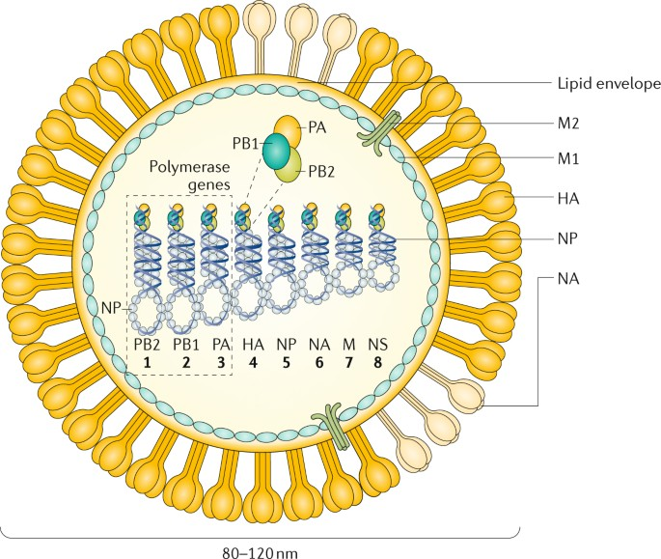
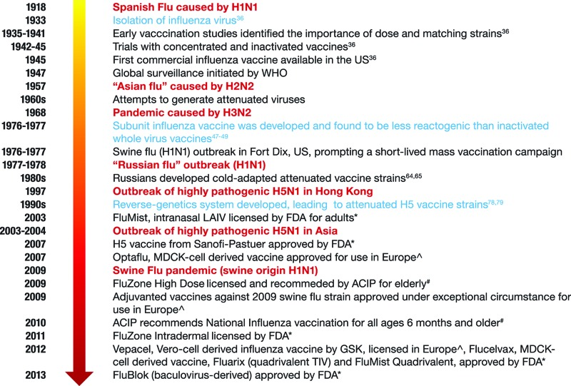
Drugs
M2 inhibitors Neuraminidase inhibitors
Polymerase inhibitors
Vaccination
Influenza A virus [5]
Two types of influenza vaccine are widely available: inactivated influenza vaccines (IIV) and live attenuated influenza vaccines (LAIV) + subunit vaccines [1]
From [3]
”The influenza polymerase has no proofreading activity, resulting in a high gene mutation rate of approximately one error per replicated genome, so each cell can produce 10,000 new viral mutants to infect neighboring cells” [2]
Gene shift =>
drug resistance,
escape from immunity
Development of
cold-adapted
vaccines [4]
1. https://www.euro.who.int/en/health-topics/communicable-diseases/influenza/vaccination/types-of-seasonal-influenza-vaccine
3. Wong SS, Webby RJ. Traditional and new influenza vaccines. Clin Microbiol Rev. 2013 Jul;26(3):476-92. doi: 10.1128/CMR.00097-12. PMID: 23824369; PMCID: PMC3719499.
2. Boivin S, Cusack S, Ruigrok RW, Hart DJ. Influenza A virus polymerase: structural insights into replication and host adaptation mechanisms. J Biol Chem. 2010 Sep 10;285(37):28411-7. doi: 10.1074/jbc.R110.117531. Epub 2010 Jun 10. PMID: 20538599; PMCID: PMC2937865.
4.Polezhaev FI, Garmashova LM, Polyakov YM, Golubev DB, Aleksandrova GI. Conditions for production of thermosensitive attenuated influenza virus recombinants. Acta Virol. 1978 Jul;22(4):263-9. PMID: 29464.
5.Krammer, F., Smith, G.J.D., Fouchier, R.A.M. et al. Influenza. Nat Rev Dis Primers 4, 3 (2018). https://doi.org/10.1038/s41572-018-0002-y

Slide 3
Cold-Adapted Vaccines
ATTENUATION
Virus growth in chicken embryos
Cold-Adaptation
Temperature sensitive strains selection
Incubation at temperature,
lower than optimal. Spontaneus mutations.
Adaptation.
”The influenza polymerase has no proofreading activity”
Negative selection: Growth @ 37℃
Cold-Adapted strains can grow at conditions suitable for manufacturing
Temperature-sensitive strains cannot replicate at human organism temperature
Stability Test
Cold-adapted temperature-sensitive strain
Long Development Cycle

Slide 4
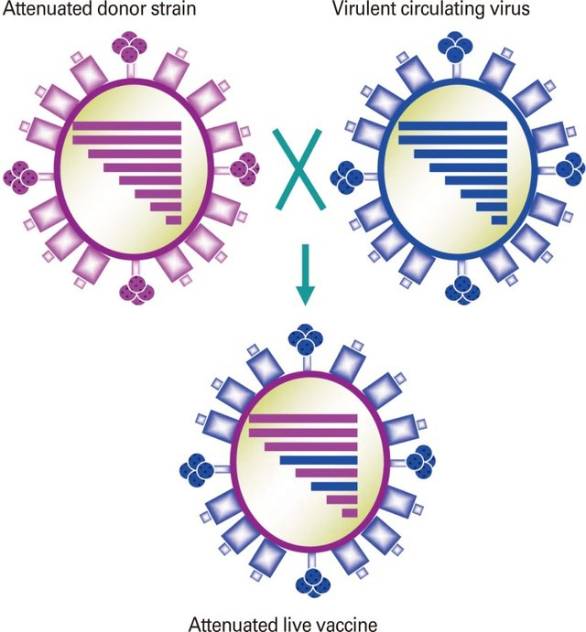
Cold-adapted temperature-sensitive strain as a donor of attenuation [6]
Reverse genetics system [7]
Cold-adapted temperature-sensitive strain
Initial (wild-type) strain
5.Krammer, F., Smith, G.J.D., Fouchier, R.A.M. et al. Influenza. Nat Rev Dis Primers 4, 3 (2018). https://doi.org/10.1038/s41572-018-0002-y
Genome sequencing
6.Jang YH, Seong BL. Principles underlying rational design of live attenuated influenza vaccines. Clin Exp Vaccine Res. 2012 Jul;1(1):35-49. doi: 10.7774/cevr.2012.1.1.35. Epub 2012 Jul 31. PMID: 23596576; PMCID: PMC3623510.
List of mutations
7. Li J, Arévalo MT, Zeng M. Engineering influenza viral vectors. Bioengineered. 2013 Jan-Feb;4(1):9-14. doi: 10.4161/bioe.21950. Epub 2012 Aug 24. PMID: 22922205; PMCID: PMC3566024.
Genotype-phenotype analysis

Slide 5
E292G mutation in NP is correlated with cold-adaptivity [8]
MW – around 100*56 kDa + RNA
MD simulations: 24*56 kDa + RNA
around 2 months @ SPbPU
WT NP 299K 312K
E292G NP 299K 312K
Cryo-EM based structure. Residues 292 are designated as red balls
8. Pulkina AA, Sergeeva MV, Petrov SV, Fadeev AV, Komissarov AB, Romanovskaya-Romanko EA, Potapchuk MV, Tsybalova LM. [Impact of mutations in nucleoprotein on replication of influenza virus A/Hong Kong/1/68/162/35 reassortants at different temperatures]. Mol Biol (Mosk). 2017 Mar-Apr;51(2):378-383. Russian. doi: 10.7868/S0026898417010141. PMID: 28537245.
9. A.V. Shvetsov, D.V. Lebedev, Y.A. Zabrodskaya, A.A. Shaldzhyan, M.A. Egorova, D.S. Vinogradova, A.L. Konevega, A.N. Gorshkov, E.S. Ramsay, A. Radulescu, M.V. Sergeeva, M.A. Plotnikova, A.B. Komissarov, A.S. Taraskin, K.I. Lebedev, Yu.P. Garmay, V.V. Kuznetsov, V.V. Isaev-Ivanov, A.V. Vasin, L.M. Tsybalova & V.V. Egorov (2020) Cold and distant: structural features of the nucleoprotein complex of a cold-adapted influenza A virus strain, Journal of Biomolecular Structure and Dynamics, DOI: 10.1080/07391102.2020.1776636
Changing distances: E292G @299K had the opened structure like Wild type @312K [9].

Slide 6
NP SANS
In Details
Peptide model
Two residues #292 from different NP helixes
Interaction analysis of WT and E292G peptide
analogues with WT NP by SPR
Small angle neutron scattering of wild-type (wt) and E292G mutant (mt) RNP solutions at 15oC, 32oC, and 37oC. (a) Representation in double logarithmic scale I vs q, where I – scattering intensity, q – magnitude of the momentum transfer; inset – Guinier coordinates (Iq vs q2). The data for I vs q plot were multiplied by 2 (x2), 4 (x4) etc for better representation. (b) Distance distribution function P(R), calculated for SANS spectra of wild- type RNP and E292G mutant; dash lines mark R = 50 and 150 Å. The zero of wt P(R) plots were moved up to 0.0005 for better representation [9].
Temperature-dependent NP structure changes depend
on interchain interaction interface
Differential scanning fluorimetry (DSF): (a) intrinsic fluorescence (350/330 nm ratio) of tryptophan as a function of temperature in samples containing wild-type (wt) or E292G mutant (mt) RNP; (b) first derivative of (a).

Slide 7
- One amino acid substitution in the influenza A virus NP protein (E292G) can lead to global change in
protein conformational mobility
- Such a substitution leads to influenza cold-adaptivity, which is essential for development of cold-adapted strains for live attenuated vaccines
- Conformational mobility can be predicted (!) by molecular dynamics simulation and demonstrated by SANS

Slide 8
Acknowelgements
Shvetsov A.V.a,b,c, Lebedev D.V.a,c, Zabrodskaya Y.A.a,b,c,d, Shaldzhyan A.A.a,d, Egorova M.A.d, Vinogradova D.S.a,e, Konevega A.L.a,b,c, Gorshkov A.N.d, Ramsay E.S.d, Radulescu A.f, Sergeeva M.V.d, Plotnikova M.A.d, Komissarov A.B.d, Taraskin A.S.d, Lebedev K.I.d,g, Garmay Yu.P.a, Kuznetsov V.V.d, Isaev-Ivanov V.V.a, Vasin A.V.b,d,h, Tsybalova L.M.d, Egorov V.V.a,c,d,i
a Petersburg Nuclear Physics Institute named by B. P. Konstantinov of National Research Center “Kurchatov Institute”, 188300, mkr. Orlova roshcha 1, Gatchina, Russia
b Peter the Great Saint Petersburg Polytechnic University, 194064, Politekhnicheskaya 29, St. Petersburg, Russia
c National Research Centre Kurchatov Institute, 123182, Akademika Kurchatova Sq. 1, Moscow, Russia
d Smorodintsev Research Institute of Influenza, Russian Ministry of Health, 197376, Prof. Popov 15/17, St. Petersburg, Russia e NanoTemper Technologies Rus, 191167, Alexandra Nevskogo 9, office 312, St. Petersburg, Russia
f Jülich Centre for Neutron Science at Heinz Maier-Leibnitz Zentrum, Lichtenbergstr. 1, D-85747 Garching, Munich, Germany
g Pavlov First Saint Petersburg State Medical University, 197022, L'va Tolstogo 6-8, St. Petersburg, Russia
h St. Petersburg State Chemical-Pharmaceutical Academy, 197022, Prof. Popov 14A, St. Petersburg, Russia
i Federal State Budgetary Scientific Institution “Institute of Experimental Medicine”, 197376, Akademika Pavlova 12, St. Petersburg, Russia

Slide 9

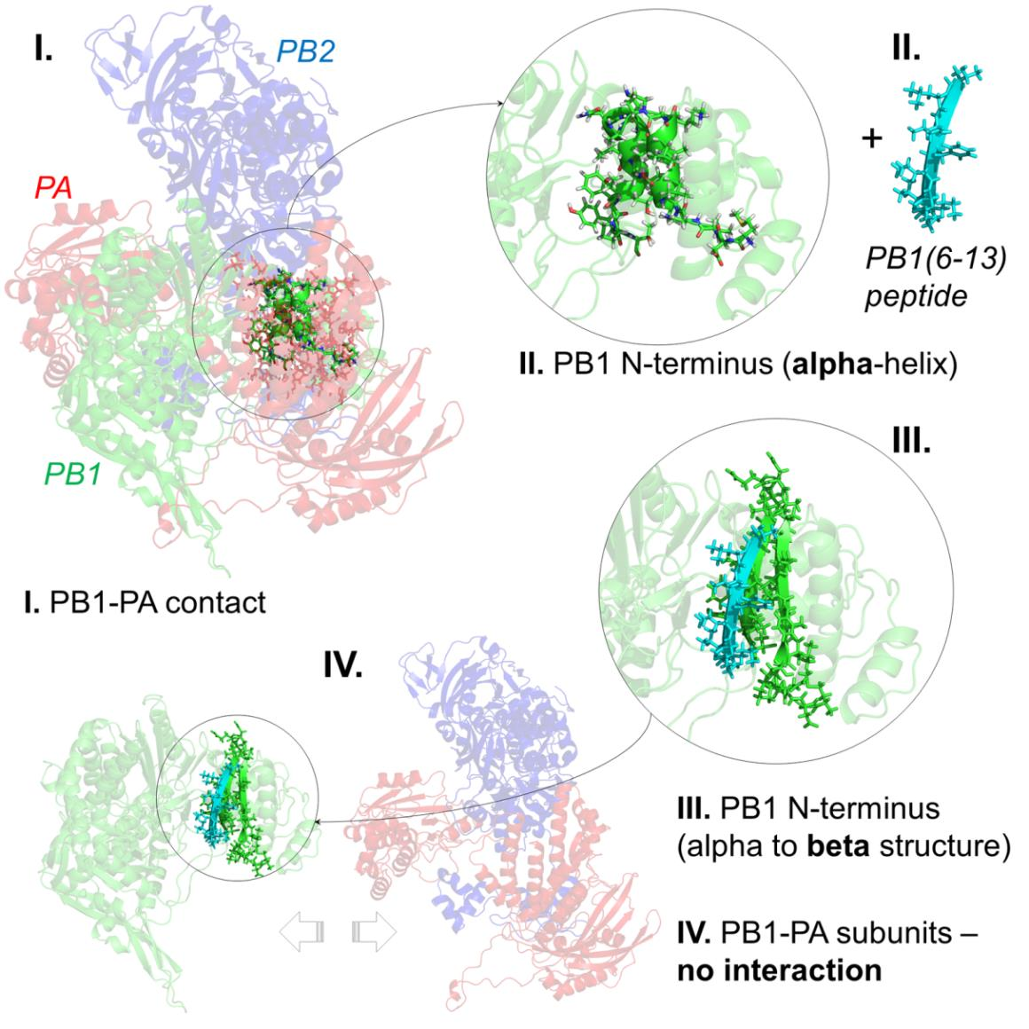
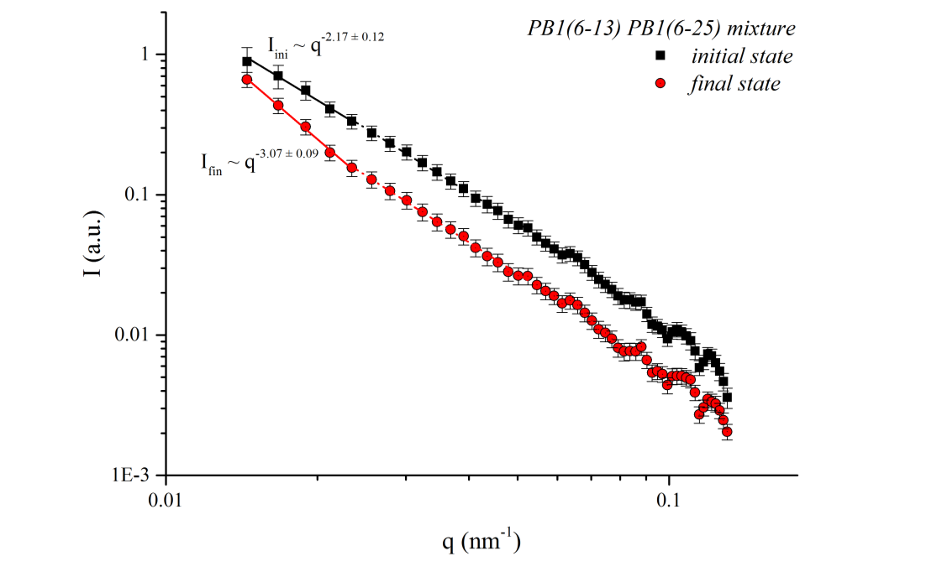
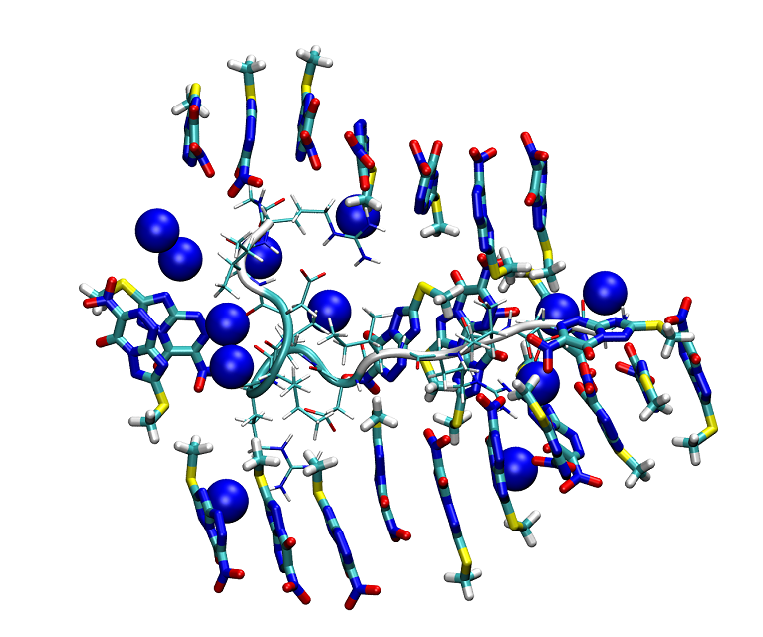
Mechanisms of action for the supramolecular drugs: neutron study
Yana Zabrodskaya, Alexey Shvetsov, Dmitry Lebedev, Yulia Gorshkova, Alexander Kuklin, Vitaly Pipich, Vladimir Isaev-Ivanov, and Vladimir Egorov
2. Supramolecular amyloid-like peptide complexes are capable of specific effects on the secondary structure of the protein, which can be used to create a new class of antiviral drugs, as was shown using small-angle neutron scattering and time-resolved x-ray scattering [4]–[6].
Interactions between SI and TZV
supramolecular complexes: MD simulation
1. Low molecular weight compounds Many low molecular weight compounds and peptides are capable of forming supramolecular complexes. In the form of such complexes, the molecules are capable of multicenter cooperative binding to target proteins. It is advisable to study these complexes using small-angle scattering methods in combination with molecular dynamics modeling in the free diffusion approach.
When studying the mechanism of interaction of a triazavirin drug with polypeptides by neutron small angle scattering methods in combination with molecular dynamics, it was shown that the drug molecules are capable of forming linear supramolecular complexes and altering the quaternary structure of proteins [1]–[3].
The PB1(6-13) and PB1(6-25) peptide mixture system initial (t = 0) and final (t = ∞) states spectra, reconstructed on the basis of a change in the singular decomposition zero and first components fro TR-SAXS SVD analysis
Small-angle neutron scattering curves analysis results of (A) – SI fibrils; (B) – SI fibrils with triazavirine. Data fitted to (A) worm-like model with fibril radius of 1.40 ± 0.04 nm and Kuhn length of 12.0 ± 0.7 nm (χ2 = 0.83, solid green line in Panel A) and (B) linear combination of random coil model (dotted red line) and long cylinders with the radii of 4.66 ± 0.14 nm (dashed blue line), χ2 = 1.2, shown in solid green line in Panel B.
Some drugs act only in the form of supramolecular complexes that are in dynamic equilibrium
Existing of such complexes cannot be detected using traditional methods - chromatography or microscopy
Only methods of light scattering, neutron scattering and X-ray scattering can be used in determination of its mechanism of action
3. The interaction of supramolecular complexes formed in lipid membranes with receptors can be used to modulate cell signaling, including the creation of immunomodulating drugs that affect T cells. The effect of complexes on the chromatin structure can be used to create a new class of drugs - epigenetic regulators that affect gene expression [7].
[1] A. V. Shvetsov, Y. A. Zabrodskaya, P. A. Nekrasov, and V. V. Egorov, “Triazavirine supramolecular complexes as modifiers of the peptide oligomeric structure,” J. Biomol. Struct. Dyn., vol. 36, no. 10, pp. 2694–2698, 2018, doi: 10.1080/07391102.2017.1367329.
[2] Y. A. Zabrodskaya, A. V Shvetsov, V. B. Tsvetkov, and V. V Egorov, “A double-edged sword: supramolecular complexes of triazavirine display multicenter binding effects which influence aggregate formation,” J. Biomol. Struct. Dyn., pp. 1–19, Aug. 2018, doi: 10.1080/07391102.2018.1507837.
[3] V. V. Egorov, Y. A. Zabrodskaya, D. V. Lebedev, A. N. Gorshkov, and A. I. Kuklin, “Structural features of the ionic self-complementary amyloidogenic peptide,” J. Phys. Conf. Ser., vol. 848, no. 1, p. 012022, 2017, doi: 10.1088/1742-6596/848/1/012022.
[4] V. V. Egorov et al., “Structural features of the peptide homologous to 6-25 fragment of influenza A PB1 protein,” Int. J. Pept., vol. 2013, p. 370832, Jan. 2013, doi: 10.1155/2013/370832.
[5] Y. A. Zabrodskaya et al., “The amyloidogenicity of the influenza virus PB1-derived peptide sheds light on its antiviral activity,” Biophys. Chem., vol. 234, no. January, pp. 16–23, 2018, doi: 10.1016/j.bpc.2018.01.001.
[6] O. V Matusevich et al., “Synthesis and antiviral activity of PB1 component of the influenza A RNA polymerase peptide fragments.,” Antiviral Res., vol. 113, pp. 4–10, Jan. 2015, doi: 10.1016/j.antiviral.2014.10.015.
[7] D. V. Lebedev et al., “Effect of alpha-lactalbumin and lactoferrin oleic acid complexes on chromatin structural organization,” Biochem. Biophys. Res. Commun., vol. 520, no. 1, pp. 136–139, 2019, doi: 10.1016/j.bbrc.2019.09.116.

