Slide 1


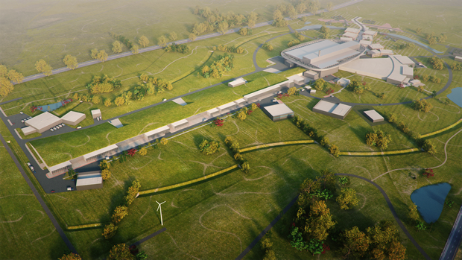
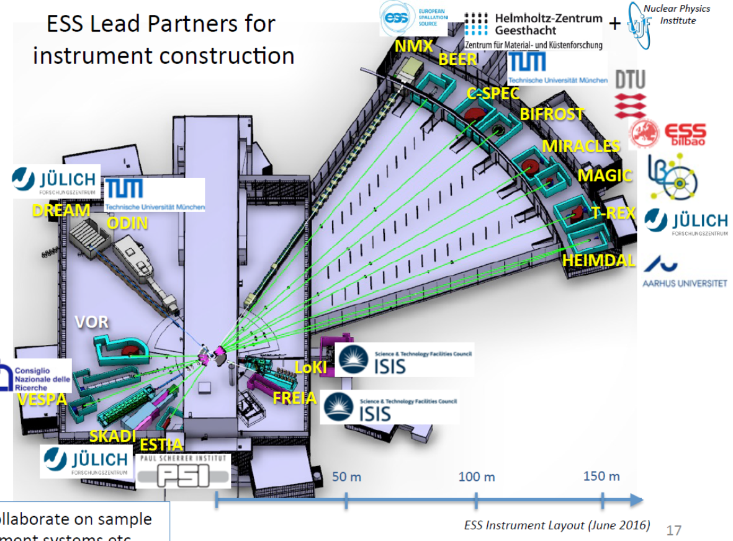
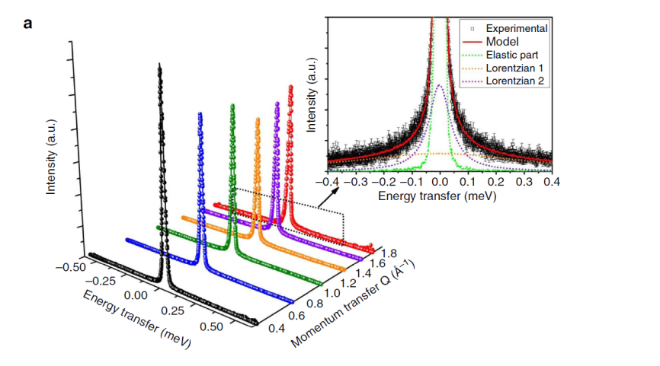
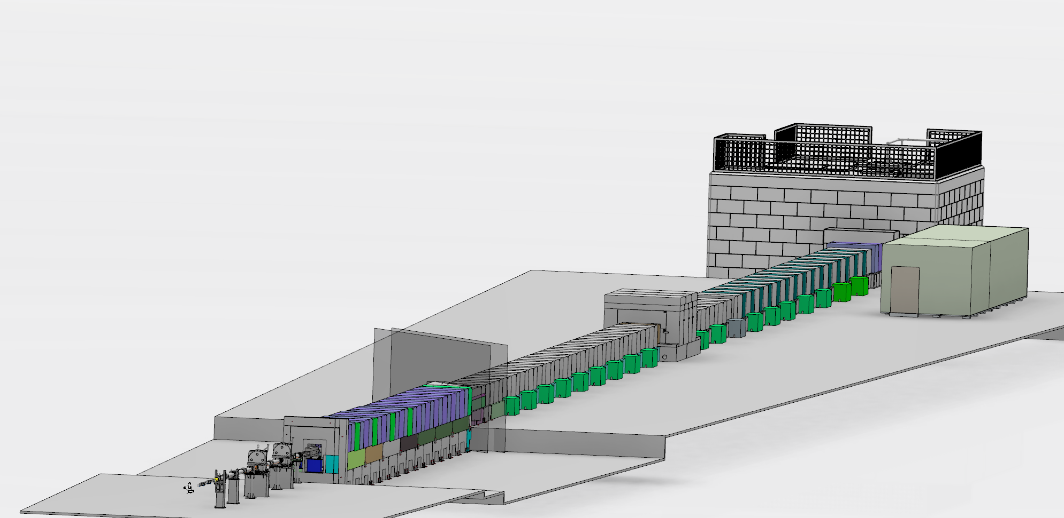
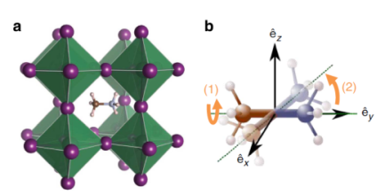
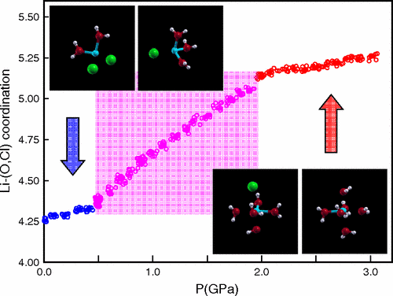
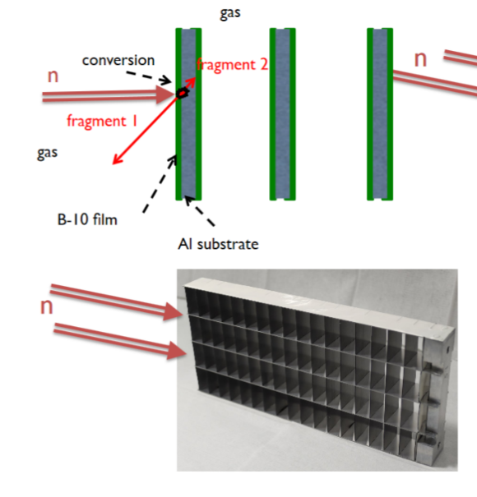
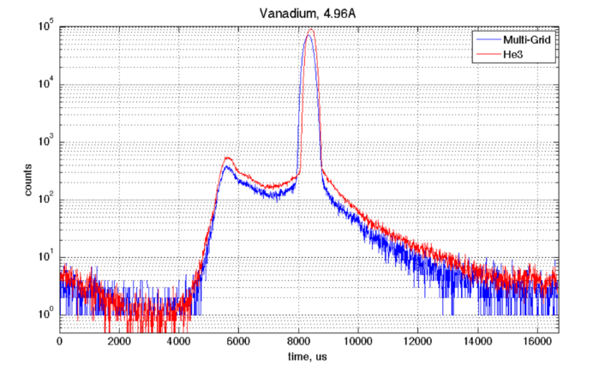
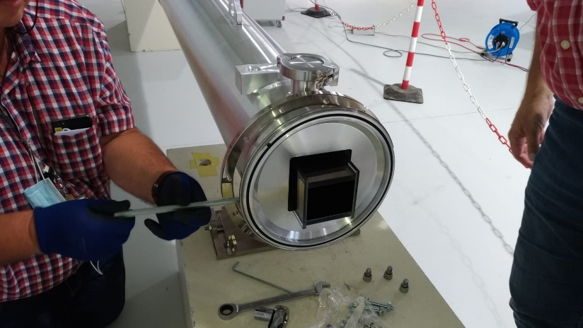
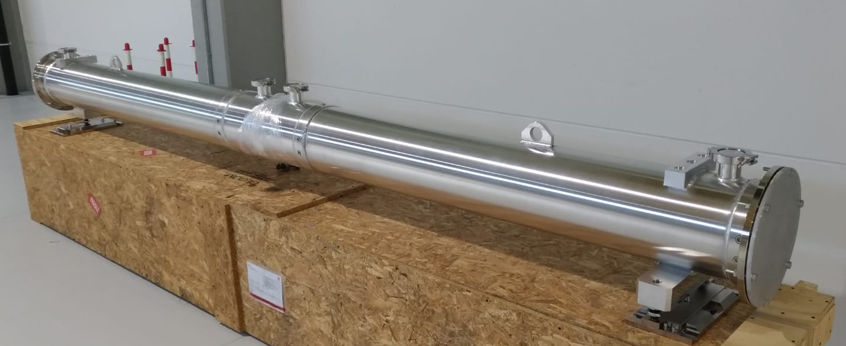

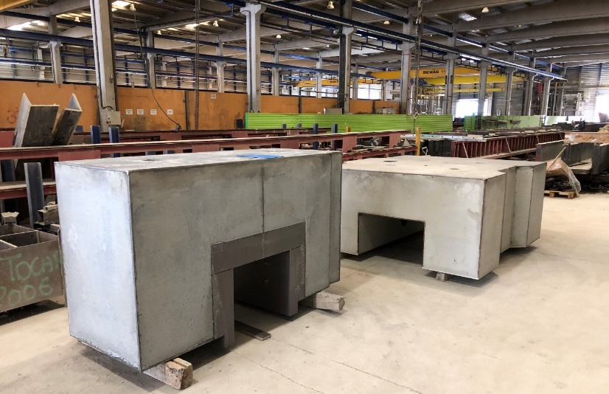
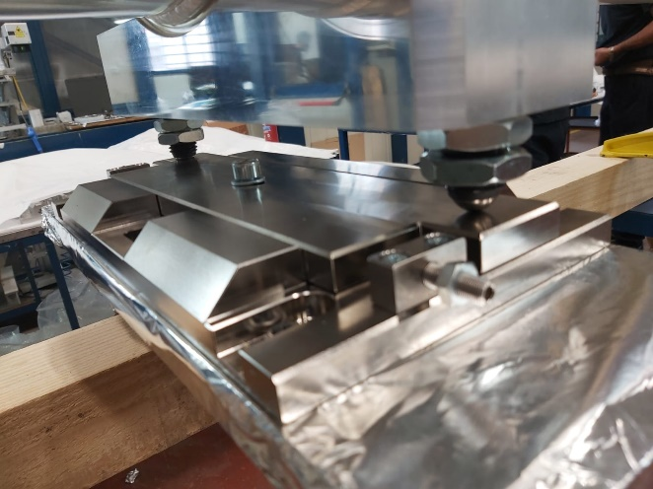
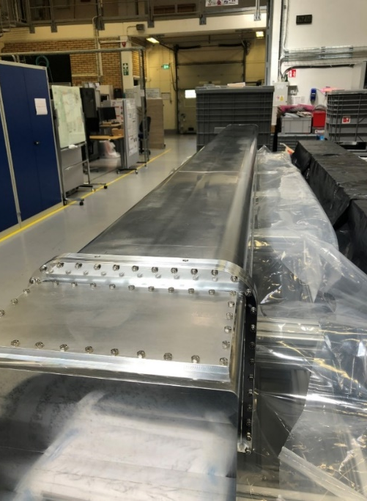
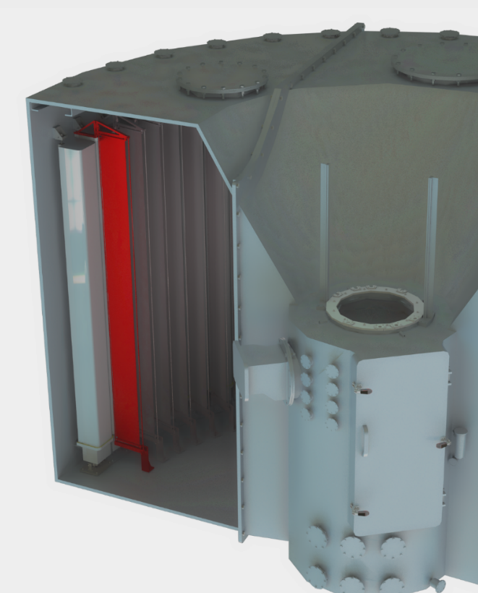
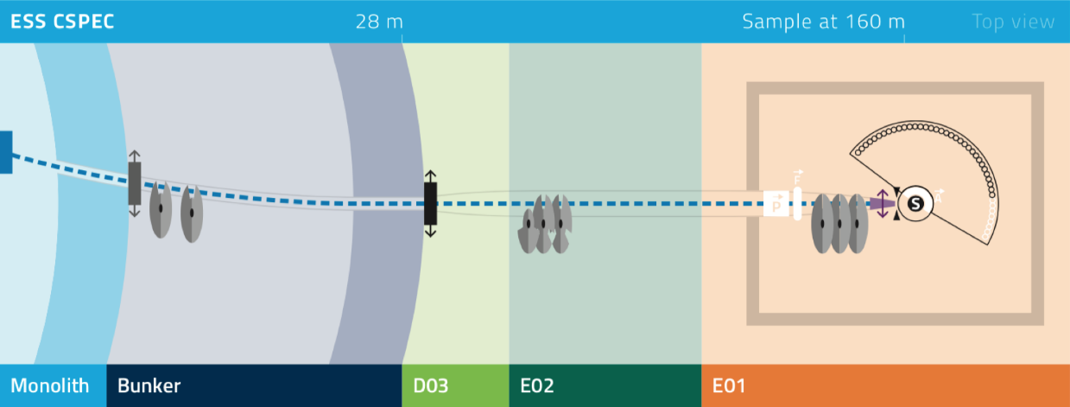
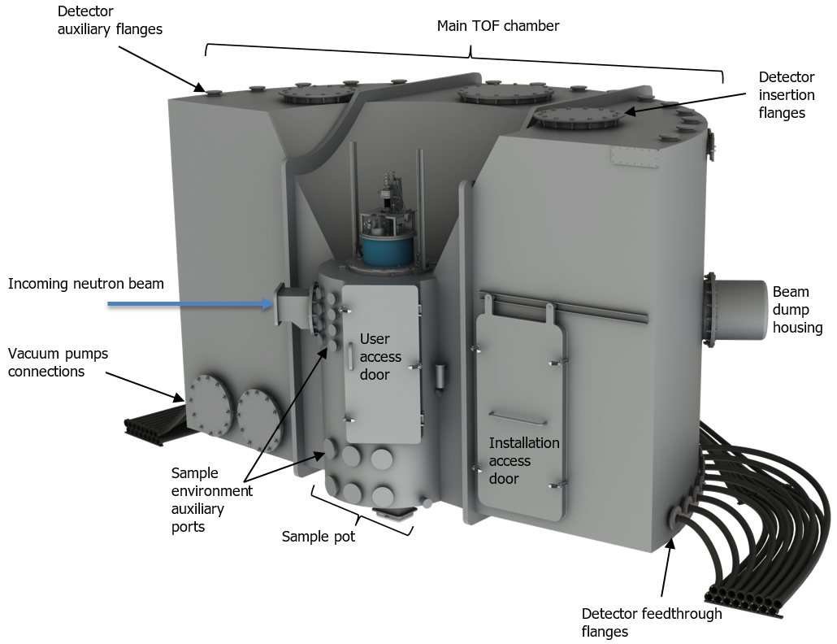
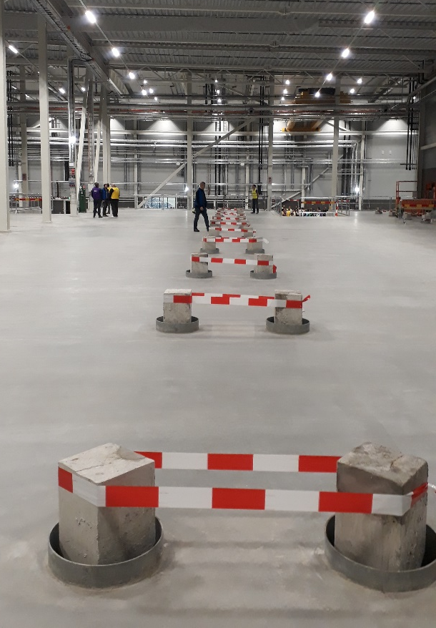
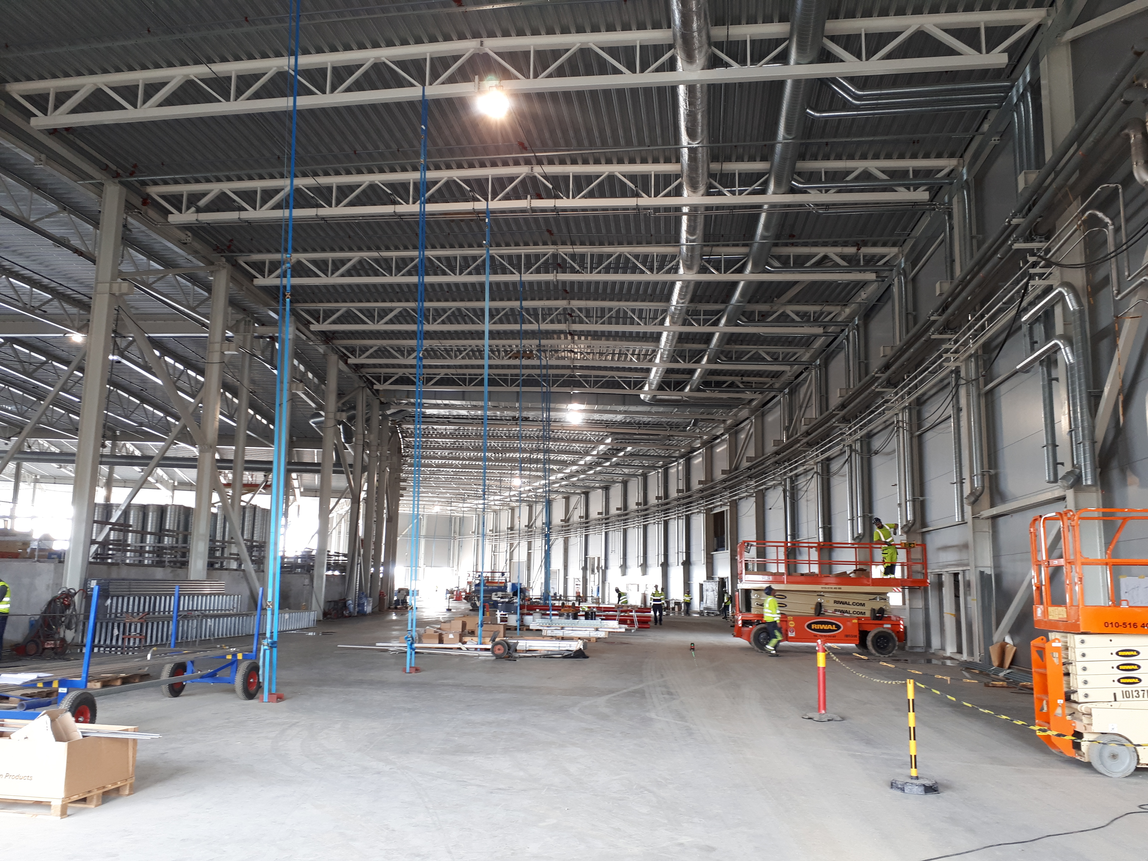
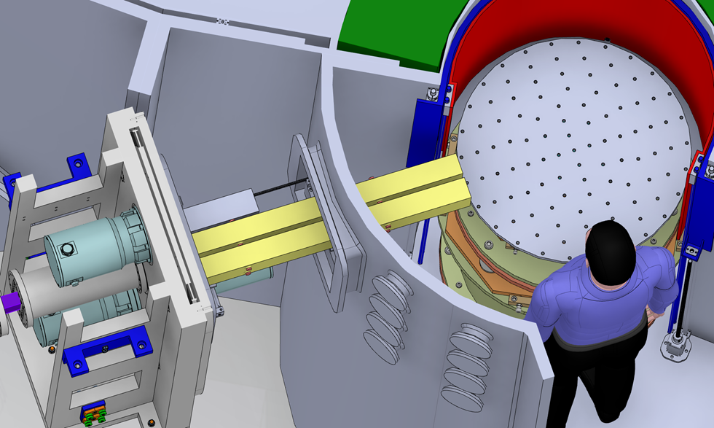
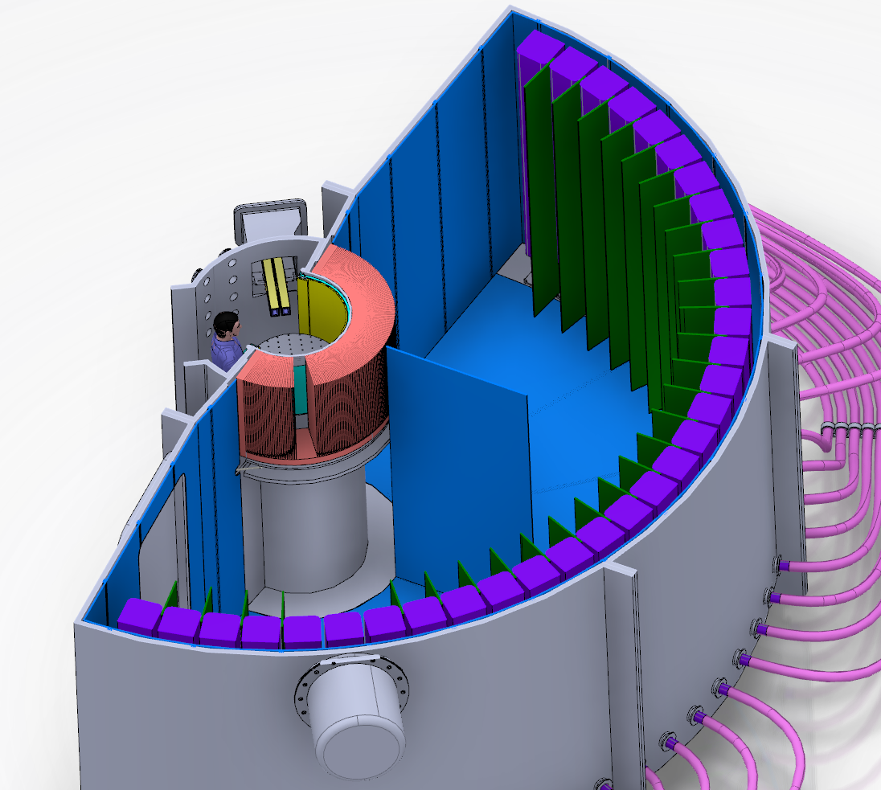
CSPEC – The cold chopper spectrometer for the ESS
P.P. Deen,^{a,b} F. Moreira,^{b,c} L. Loaiza,ª W. Lohstroh,ª D. Norefini,^{b} S. Longeville,^{c}
ª Heinz Maier-Leibnitz Zentrum (MLZ), Technische Universität München, Garching, Germany
^{b} European Spallation Source (ESS), Lund, Sweden
^{c} Laboratoire Leon Brillouin (LLB), France
European Spallation Source ESS
“The European Spallation Source (ESS) is a European Research Infrastructure Consortium (ERIC), a multi-disciplinary research facility based on the world’s most powerful neutron source. The unique capabilities of this new facility will both greatly exceed and complement those of today's leading neutron sources, enabling new opportunities for researchers across the spectrum of scientific discovery, including life sciences, energy, environmental technology, cultural heritage and fundamental physics.“ (ESS mission statement)
Instrument Suite
CSPEC – Cold Chopper Spectrometer
CSPEC characteristics
Wavelength range = 2 – 20 Å.
CSPEC shall probe excitations up from 0.005 up to 20 meV.
CSPEC shall measure in repetition rate multiplication configuration.
CSPEC shall be capable of energy resolutions down to ΔE/E = 1.5% at 4 Å
CSPEC shall be capable of spatial resolution ΔQ/Q = 2%.
CSPEC shall provide a signal to noise of 10⁵ at 5 Å
The neutron beam at the sample position shall illuminate a sample area ranging from 4 x 2 cm² to 1.0 x 1.0 cm² (height x width)
CSPEC should follow kinetic processes with time steps of one minute.
hybrid organic-inorganic perovskite solar cells CH₃NH₃PbI₃
Experimental cave
Secondary spectrometer
Beam transport and conditioning system
Primary spectrometer
E01
Leguy, Aurelien MA, et al., Nature communications 6 (2015).
E02
E02.2
high pressure ice
D03
Inside bunker
BW3 & PSC chopper pit
In monolith NBOA
Bunker wall Feedthrough
L. E. Bove, S. Klotz, J. Philippe, and A. M. Saitta
Phys. Rev. Lett. 106, 125701 (2011)
Current status of the construction project
Beam Extraction and Guide Transport System – First deliveries
10B multigrid detectors: performance
view of cold focal point of the butterfly moderator
vertical s-curved guide (radius of curvature 1600 m, loss of line-of-sight inside bunker at 26.53m)
horizontal curvature (R = 4000m) to compensate monolith insert rotation
elliptic opening / closing towards high speed choppers and sample position
< 10 % intensity variation across beam spot
4 x 2 cm² beam spot (1 x1 cm² in focused mode), height x width
divergence +/- 1 deg at 3 Å
smooth divergence profile
3.32 Å
4735 mm
4035 mm
4735 mm
4035 mm
Secondary Spectrometer & Detectors
The way to CSPEC
Sample detector distance = 3.5 m
detector angular coverage
5 – 140°horizontal
+/- 26.5°vertical (3.5 m height) (+/- 8 on day 1)
combined sample chamber & tank under vacuum (10⁻⁴ mbar)
gate window: sample environement at ambient conditions (Al window thickness 2-3 mm)
side access to sample chamber
Guide exchanger under development at LLB
Enlarged sample pot and access
Complying with SAD requirements
Radial Collimator
Collimation Vanes
2017
2019
2020
2021
2023
Thank you
P. Link(TUM), F. Horn (TUM), H. Meier(TUM), A. Cazenave (LLB), S. Desert(LLB)., G. Fabreges (LLB) N. Tsapatsaris (ESS),R. Al Jebali (ESS), A. Kaphlanov (ESS) M. Anastasopoulos (ESS), G. Laszlo (ESS), C. Lopez (ESS)
Cd inner dressing
Main TOF chamber
Phase 1
Prelim Design
Phase 2
Detailed Design
Phase 3
Procurement & Start of Installation
High speed chopper
3 carbon fiber disks
Generous space for sample handling
Detectors
Phase 4
Installation & cold commissioning
Phase 5
Hot commissioning
A. Khaplanov et al. (ESS)

