Slide 1
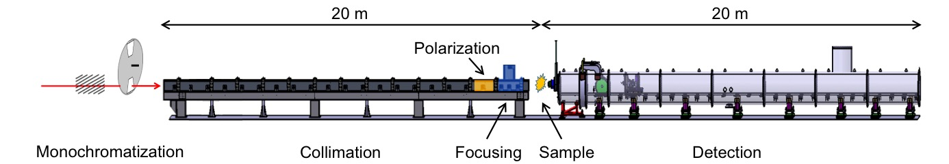
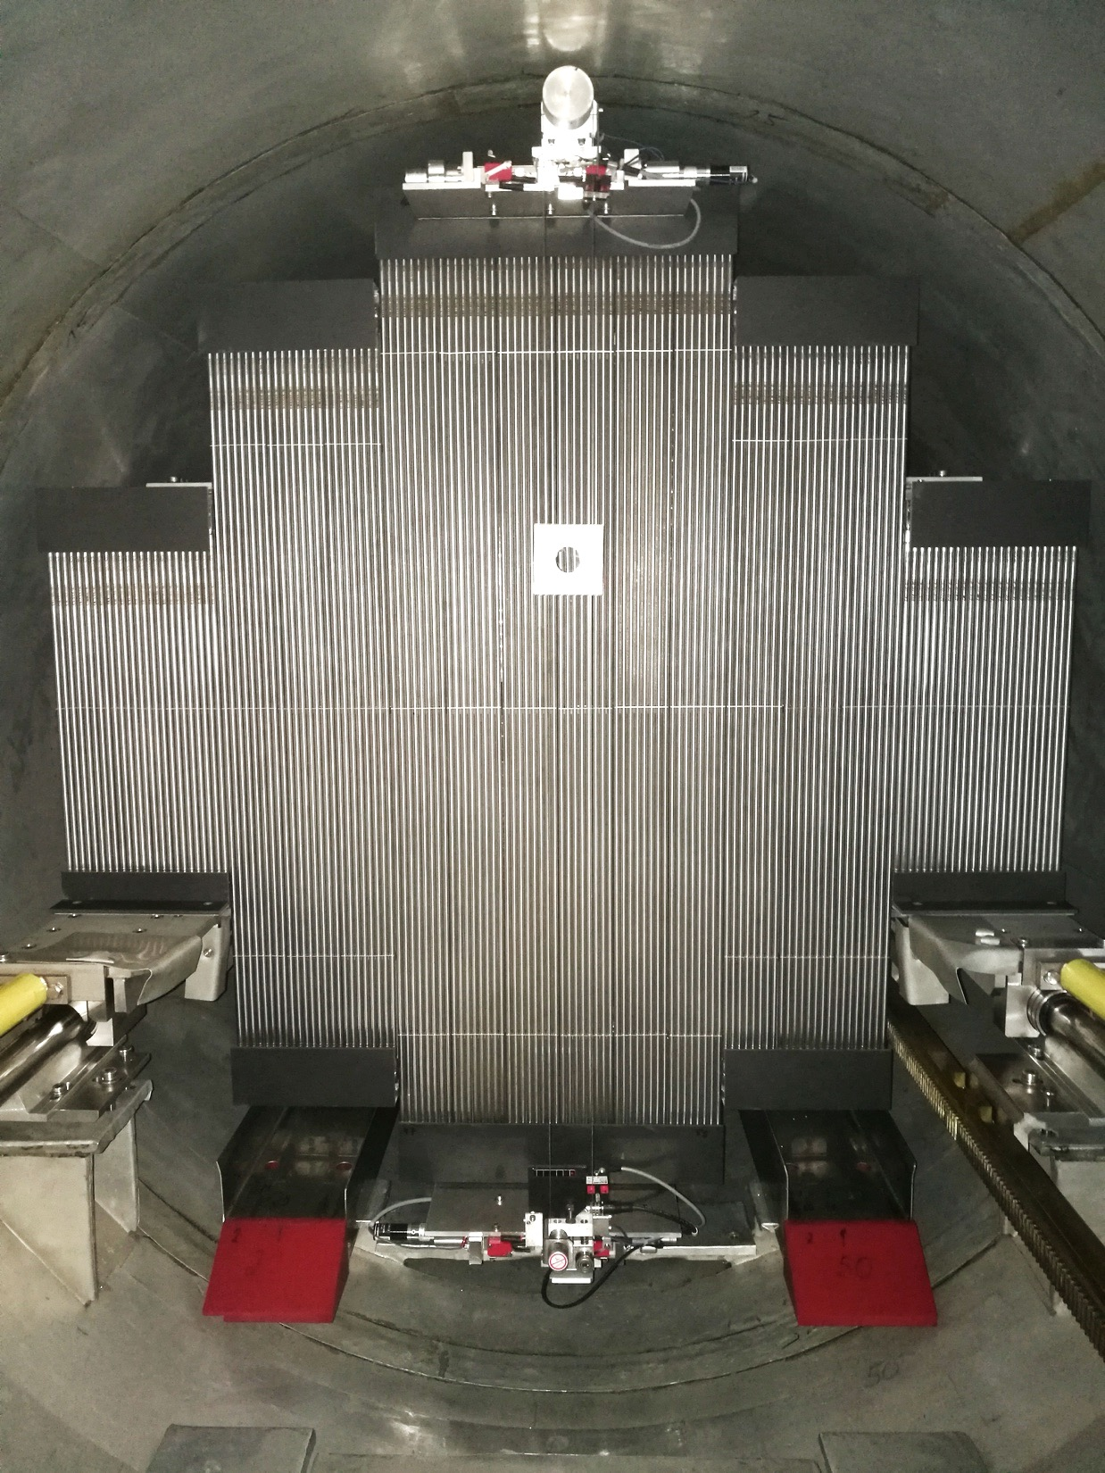
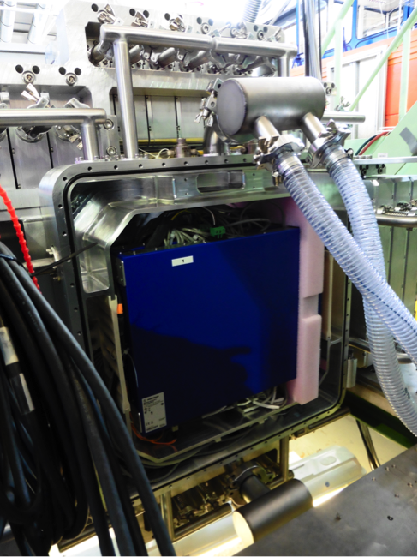
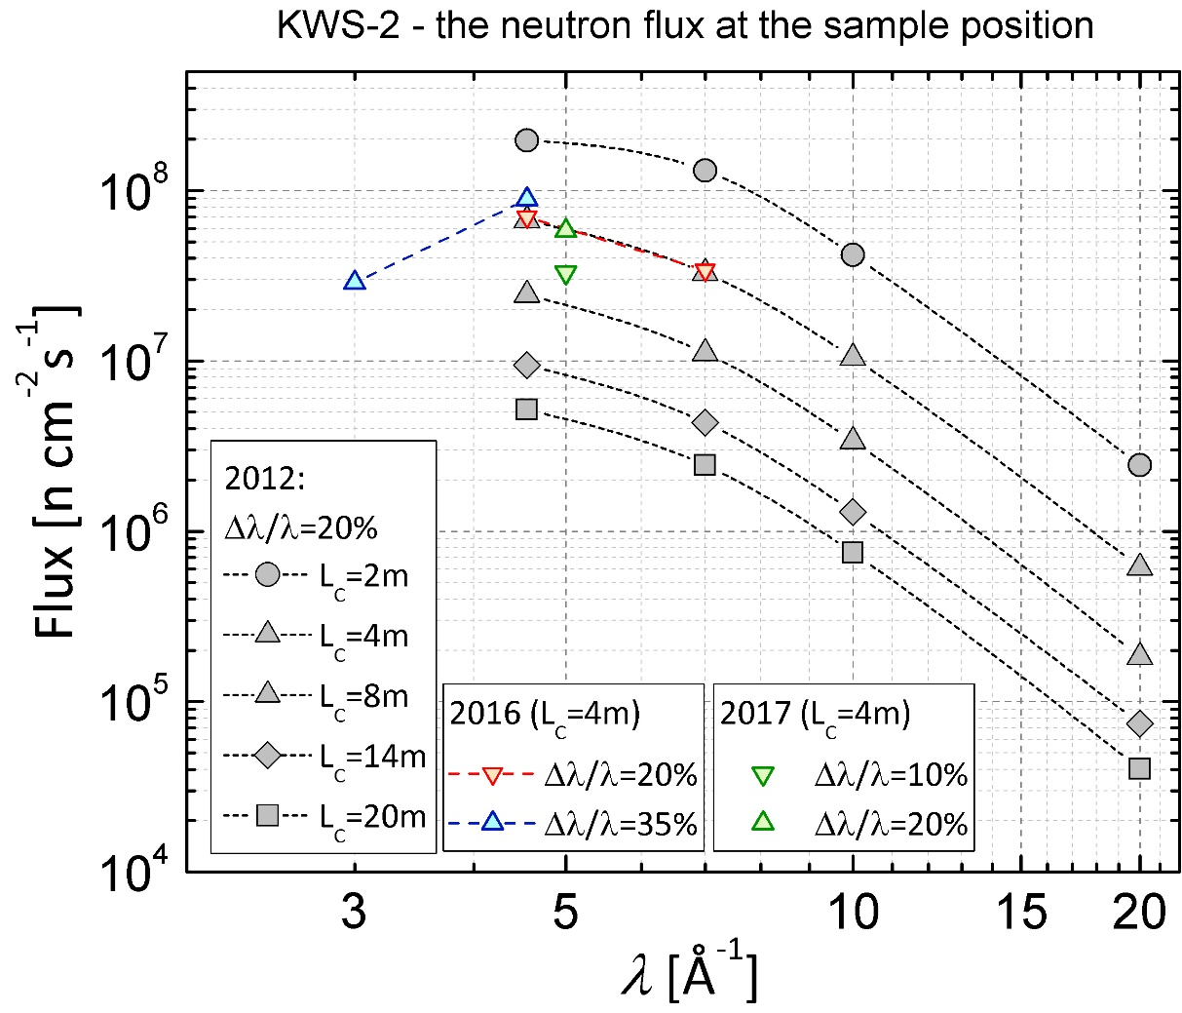
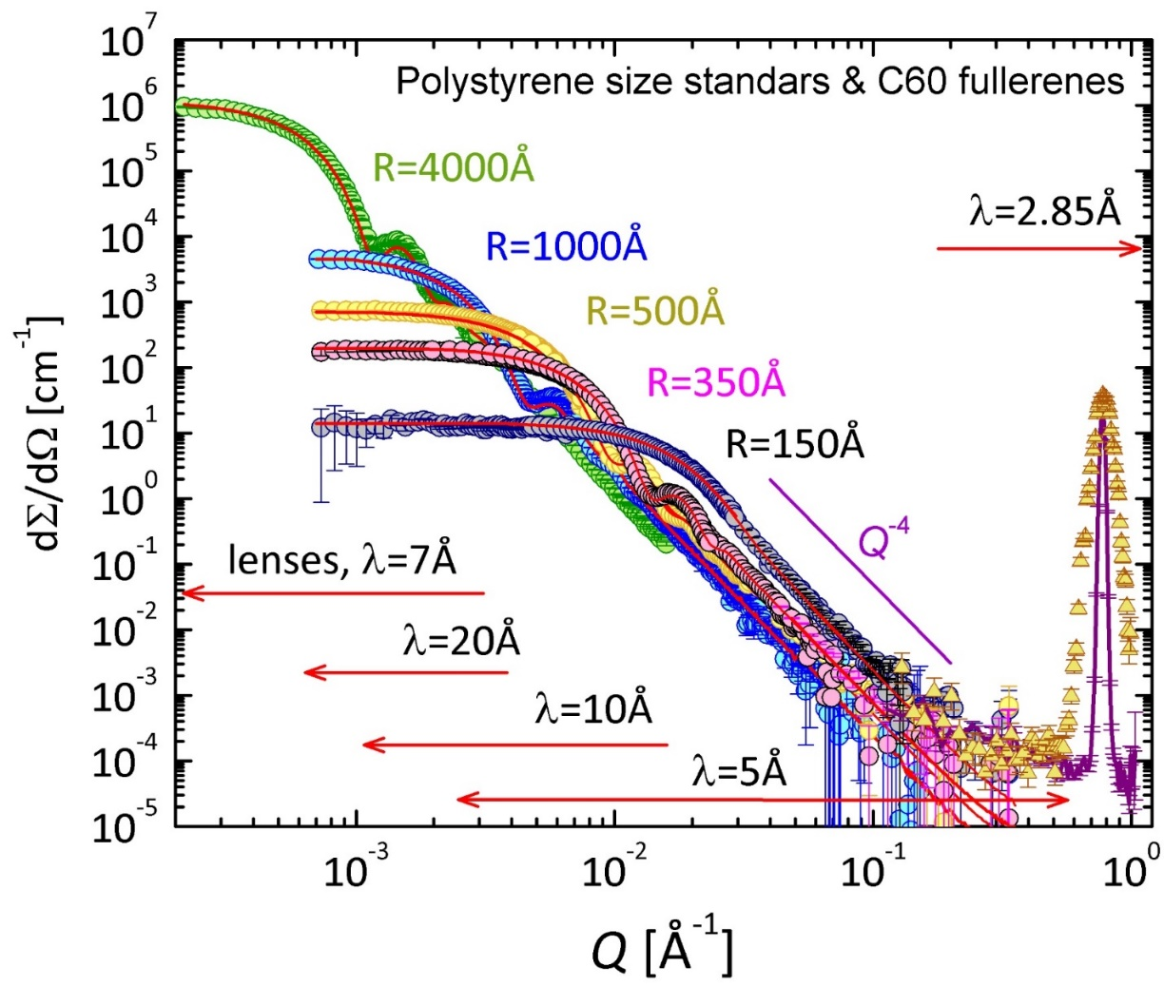
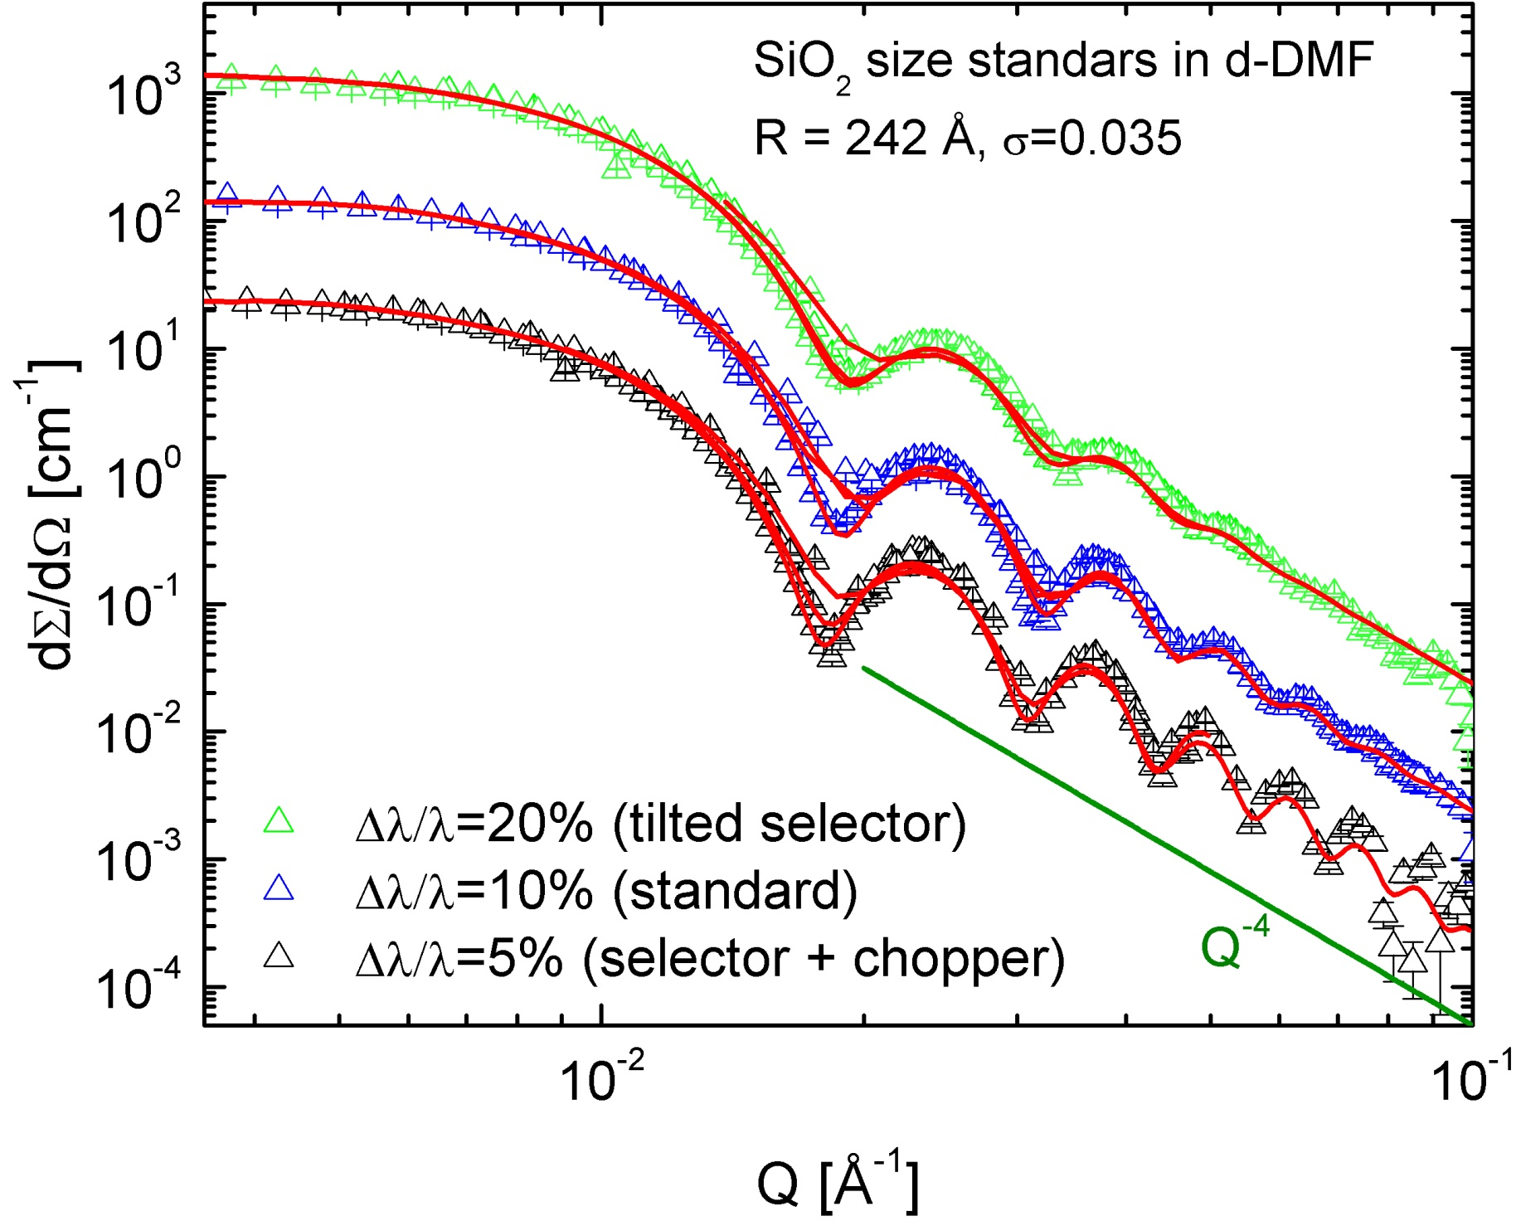
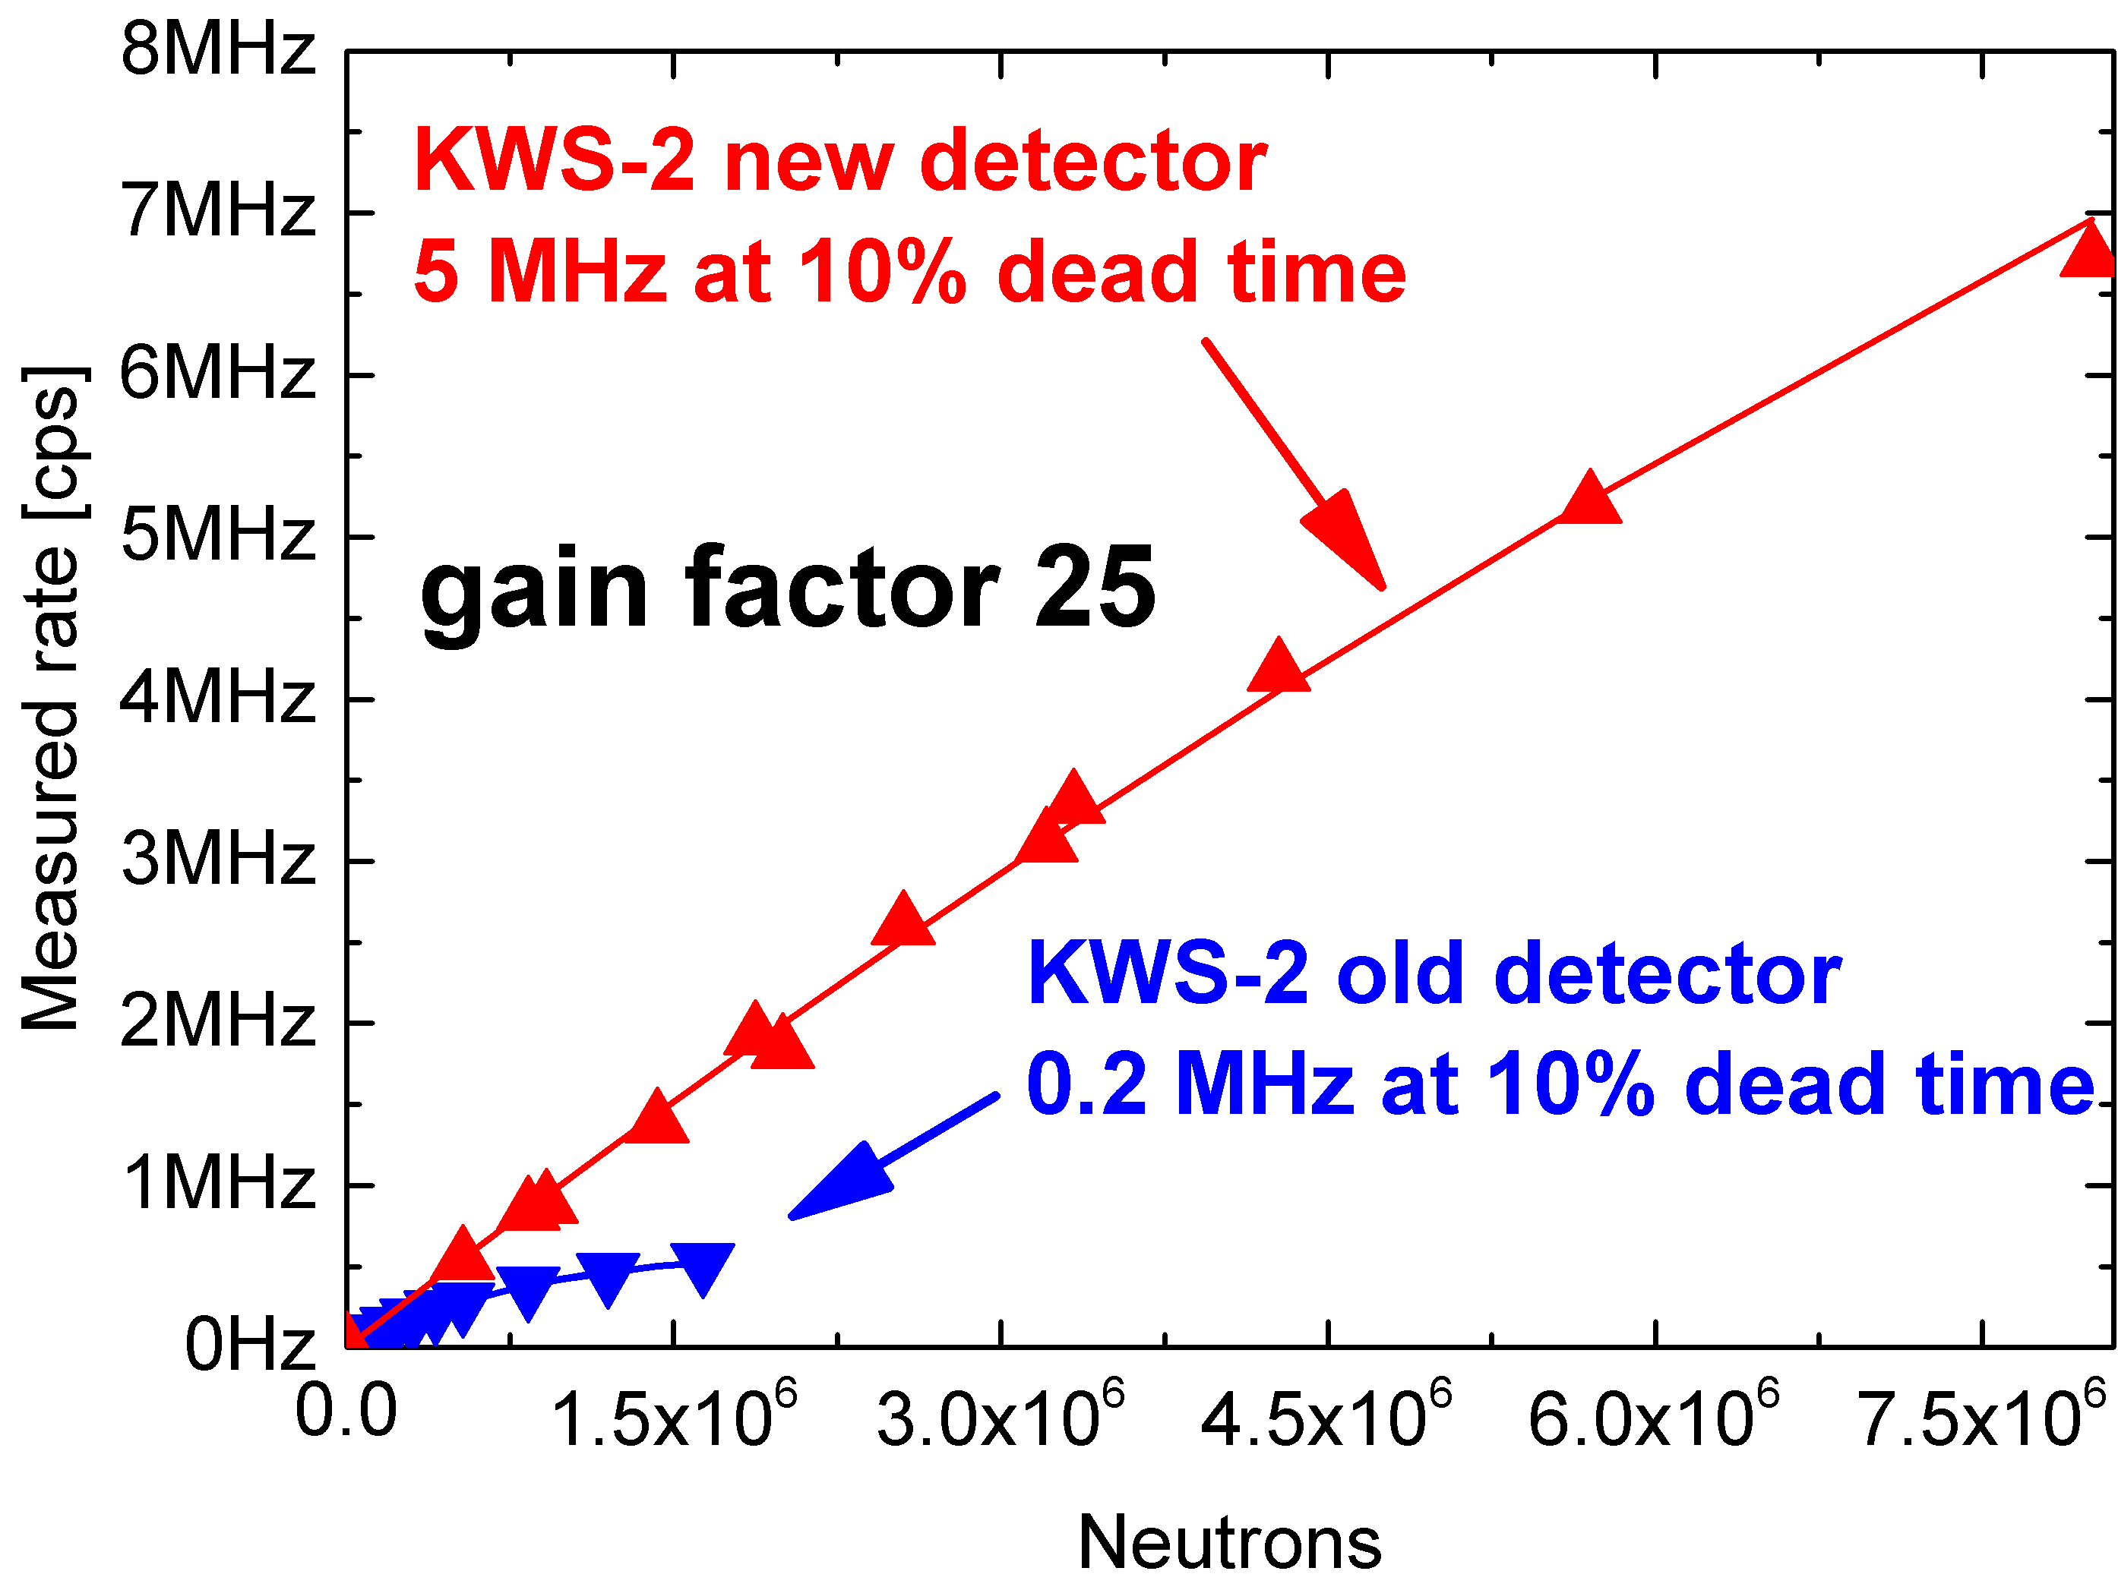
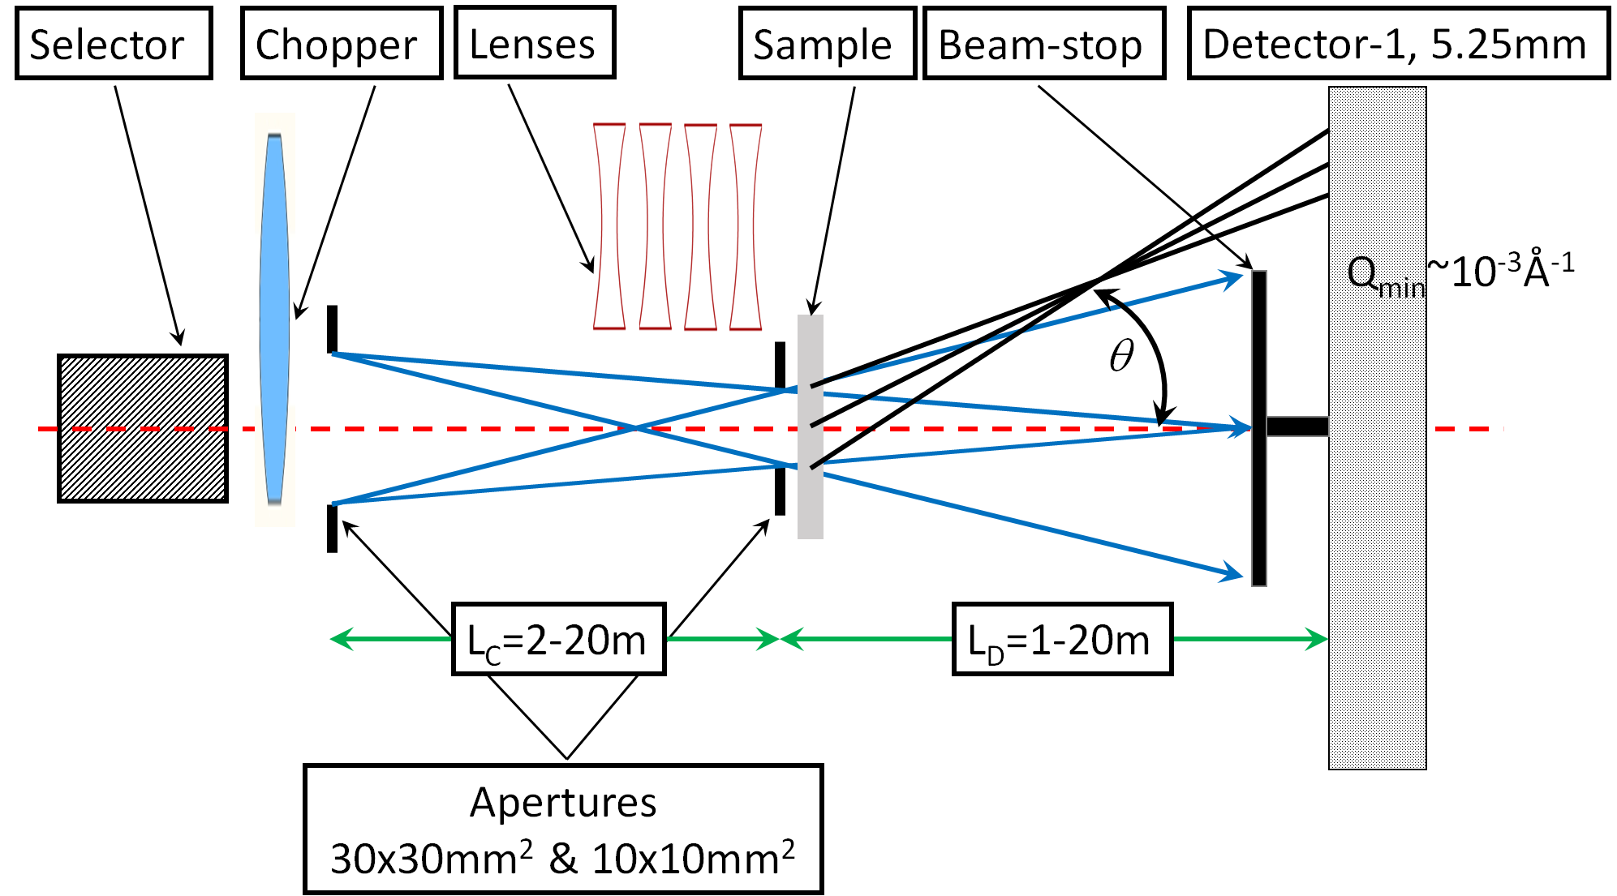
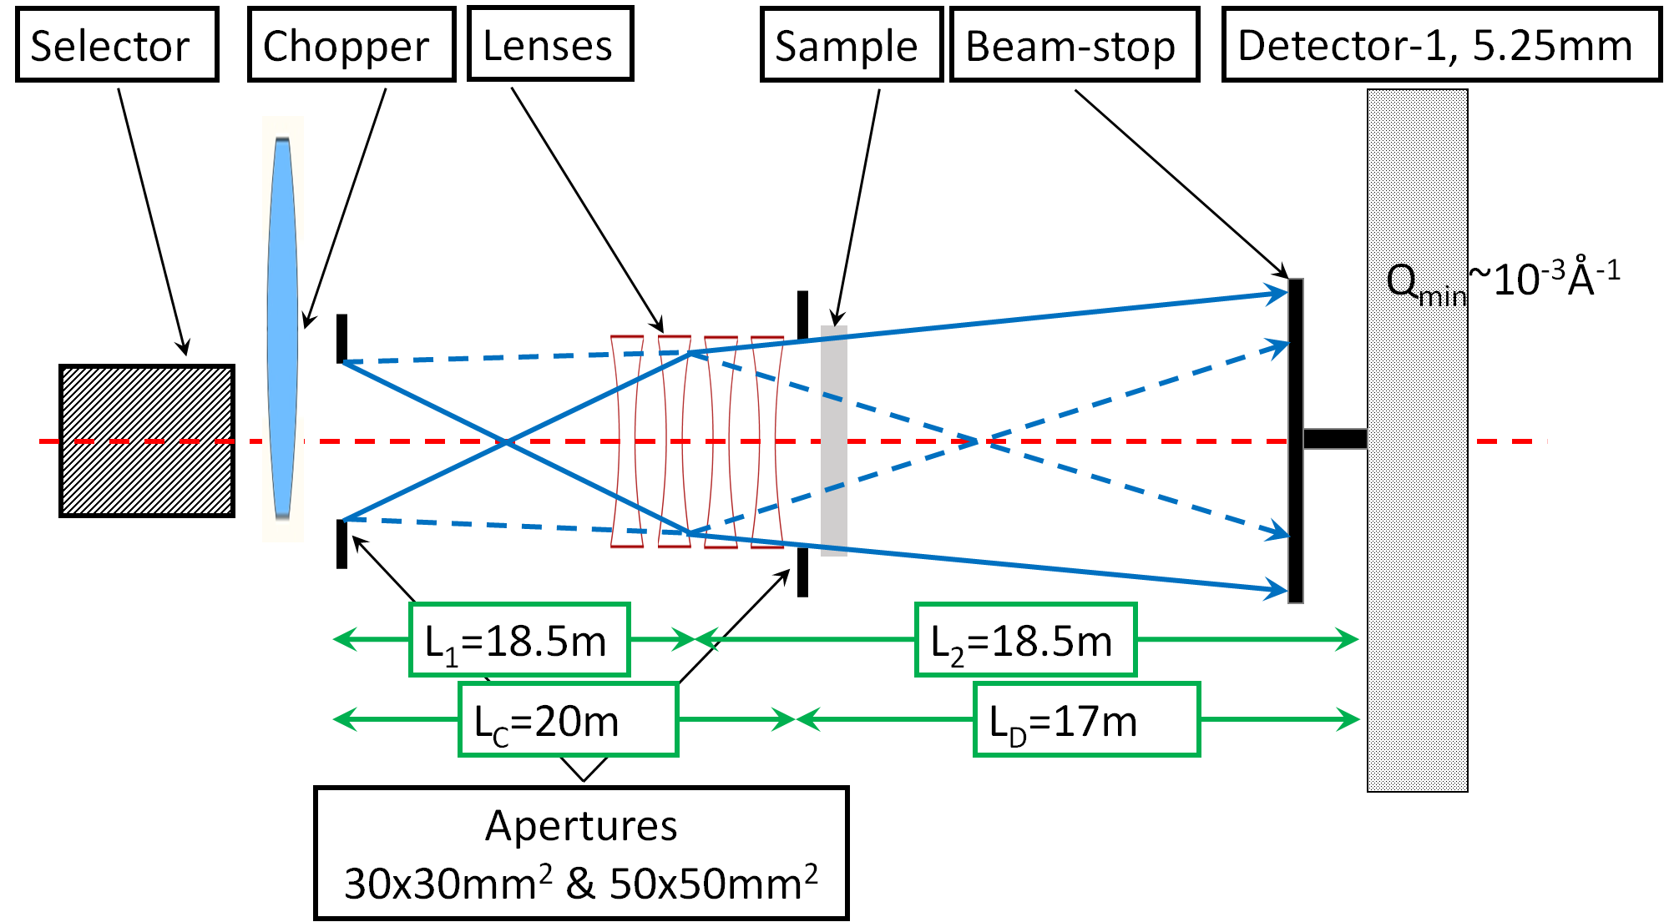
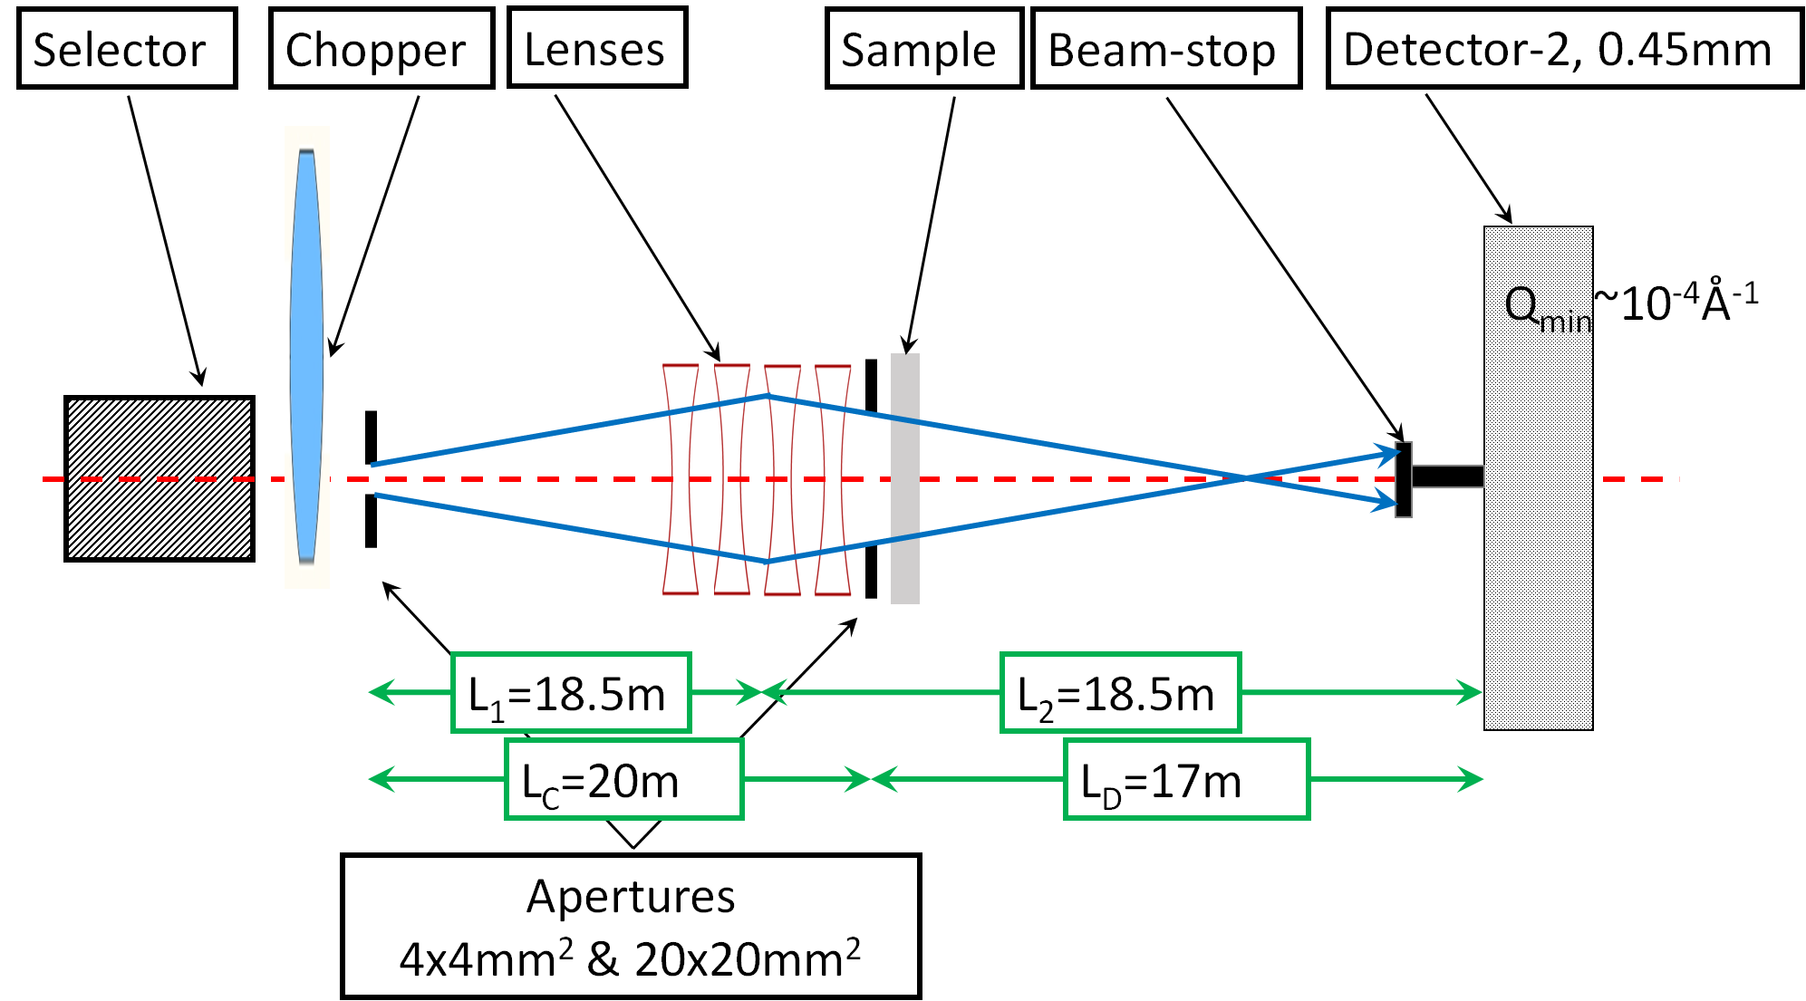
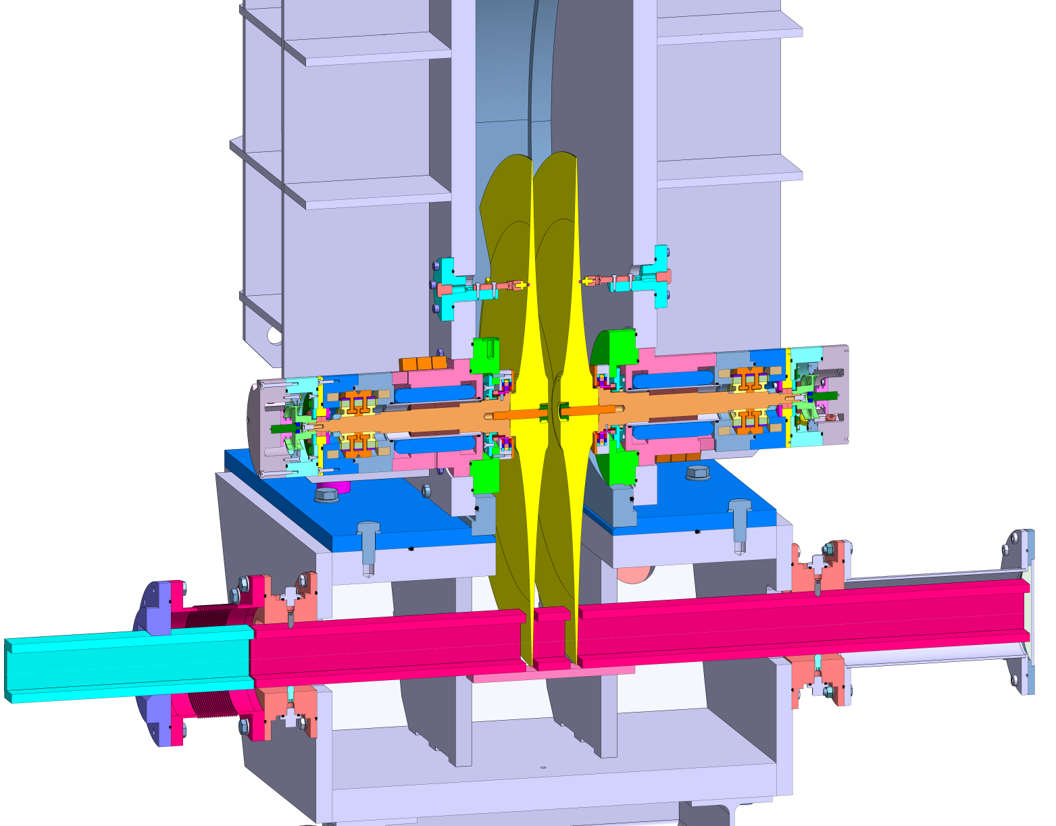
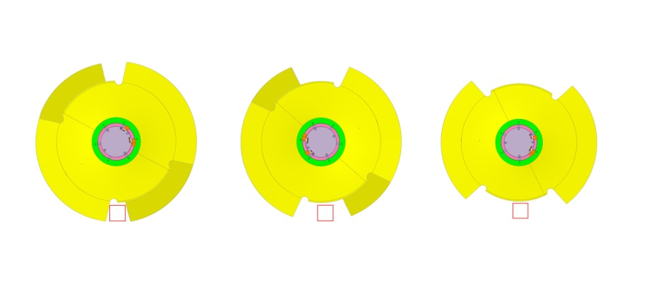
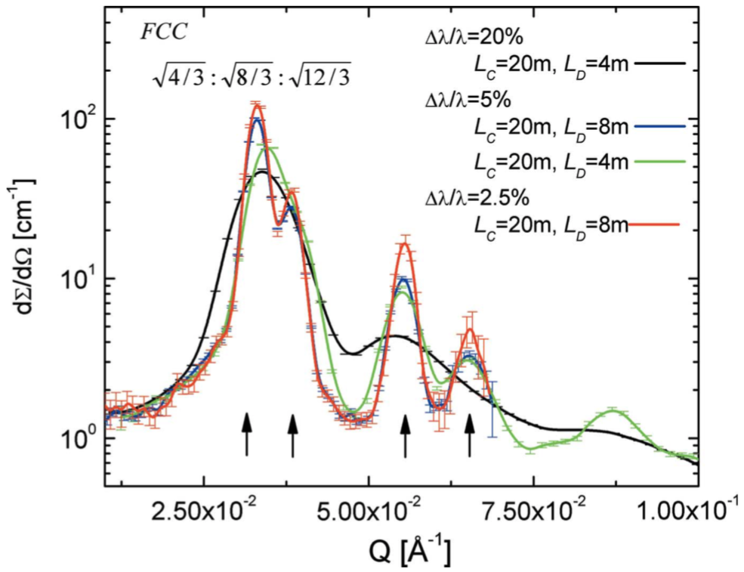
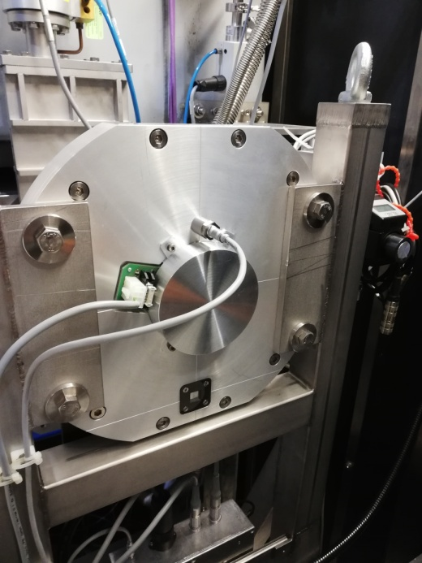
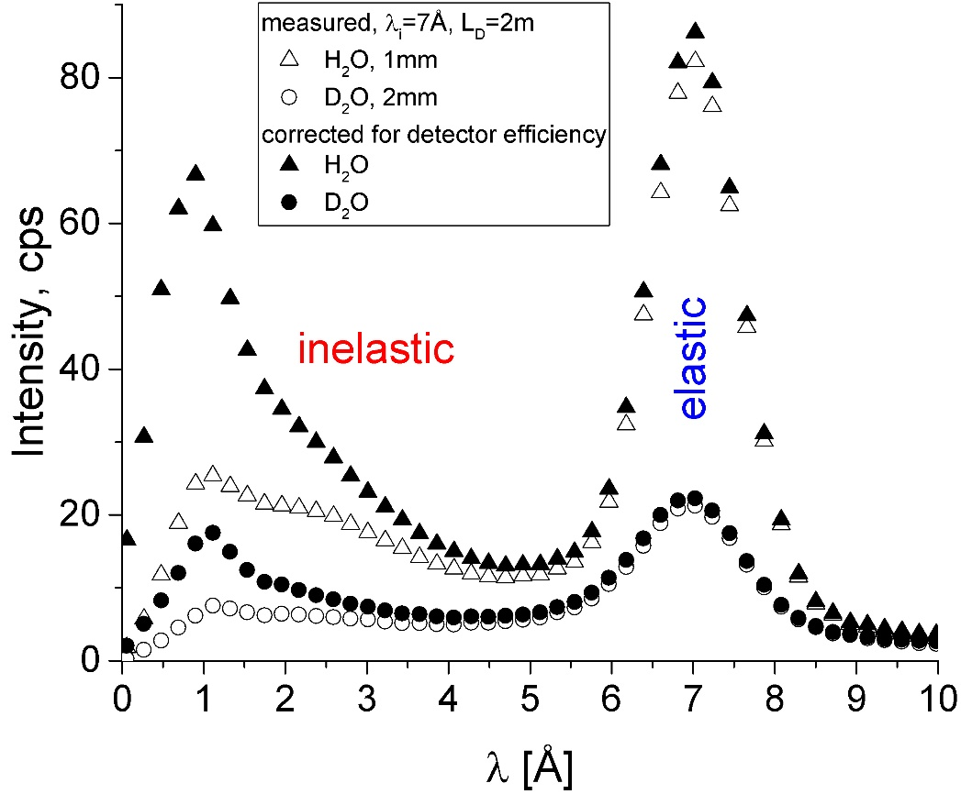
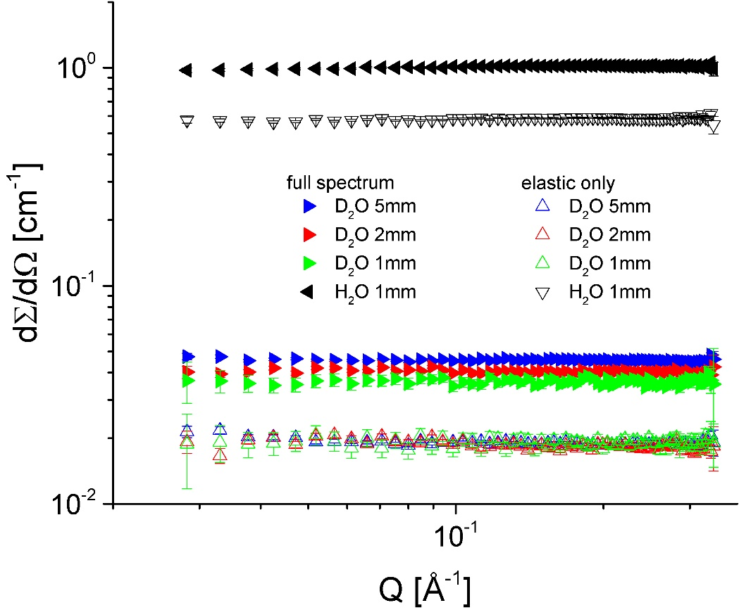
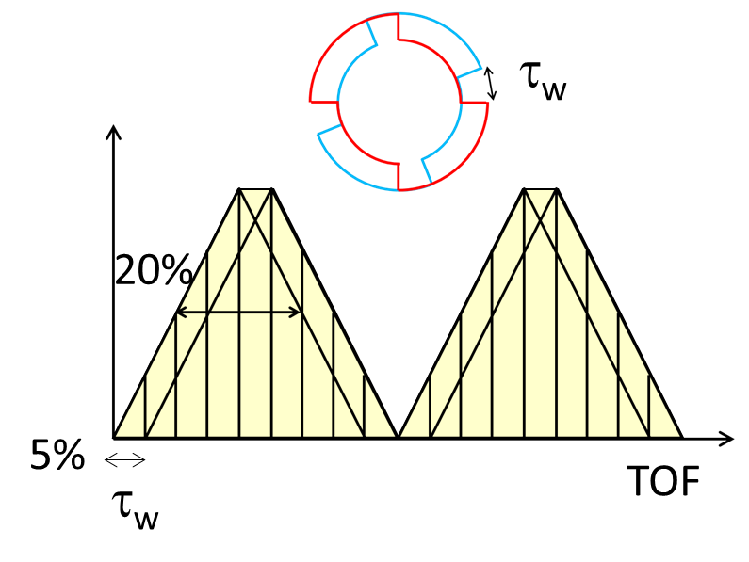
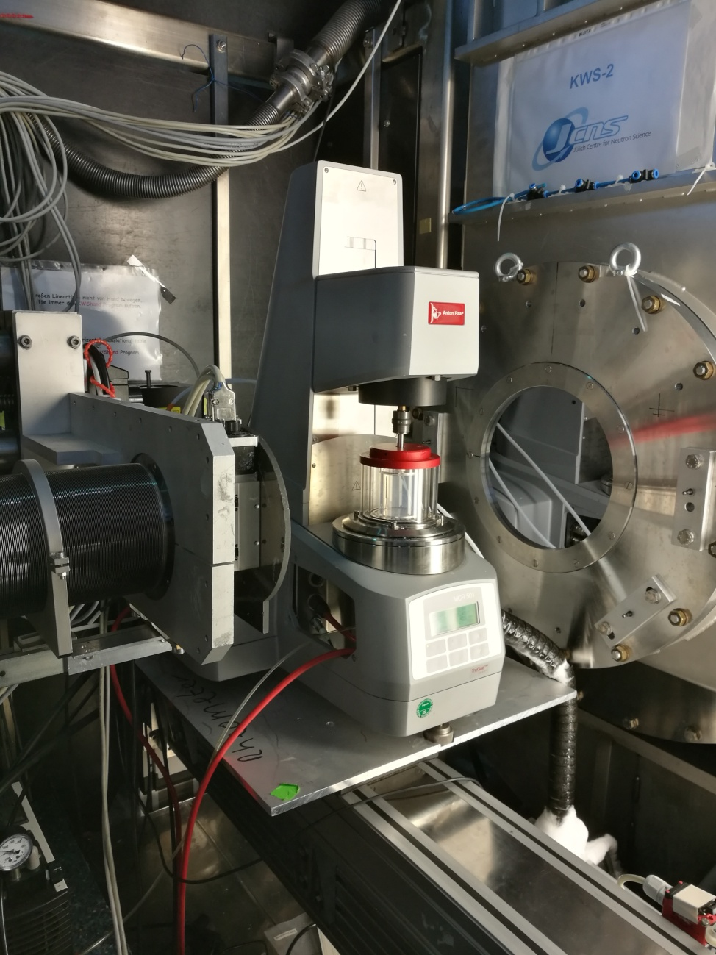
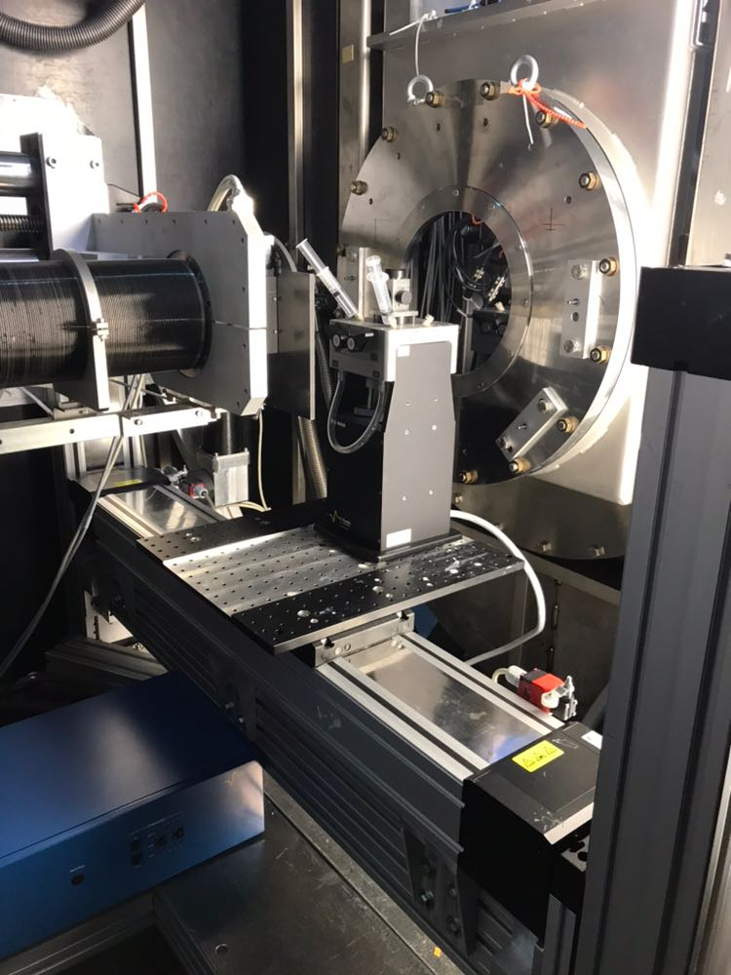
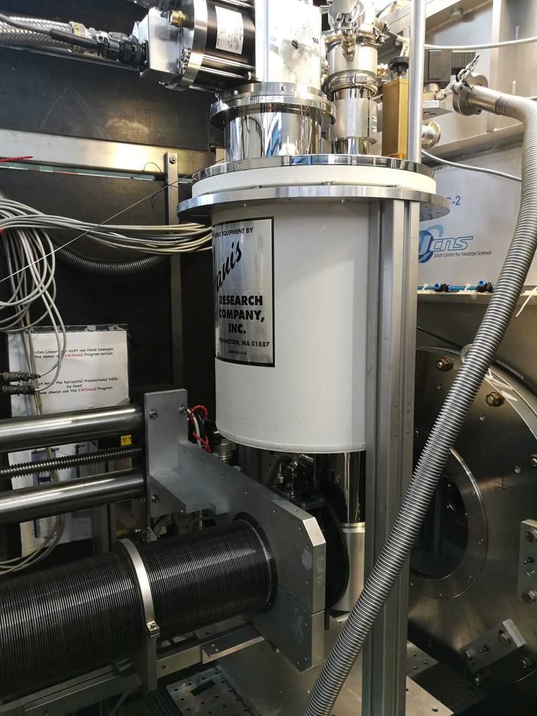
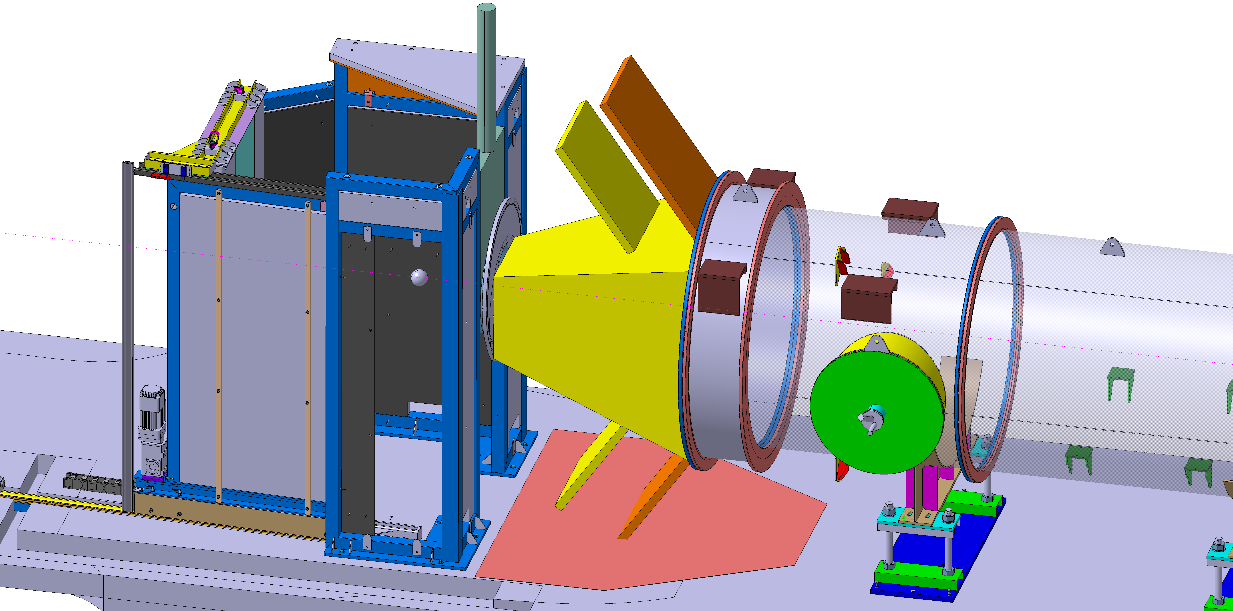
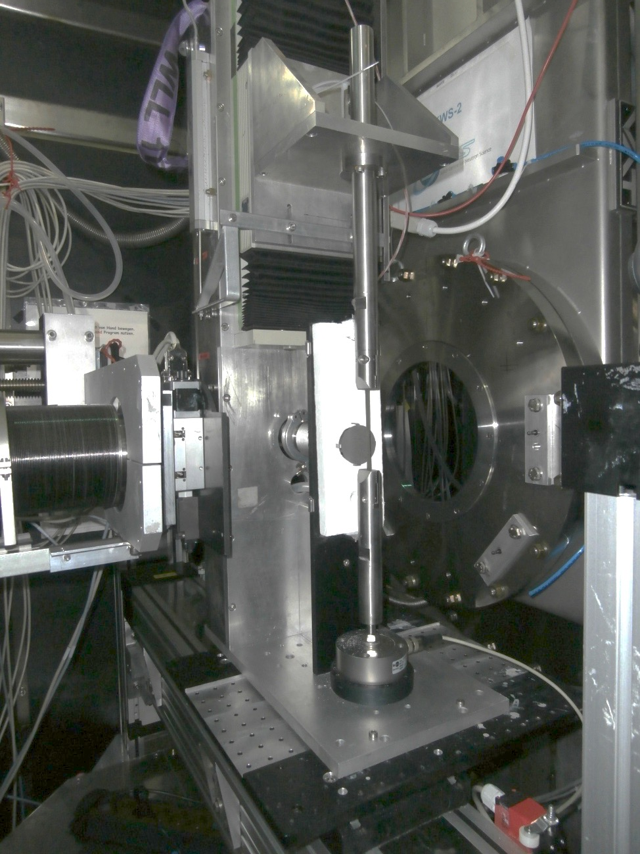
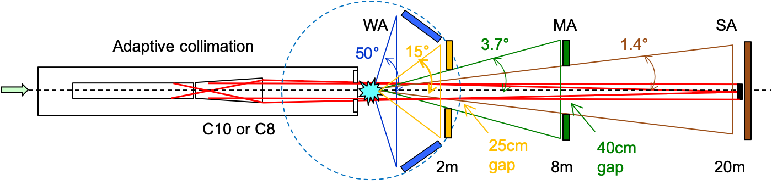
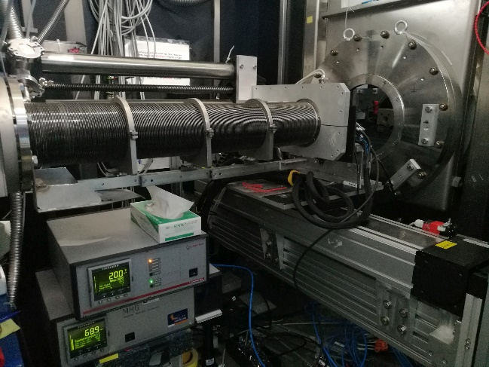
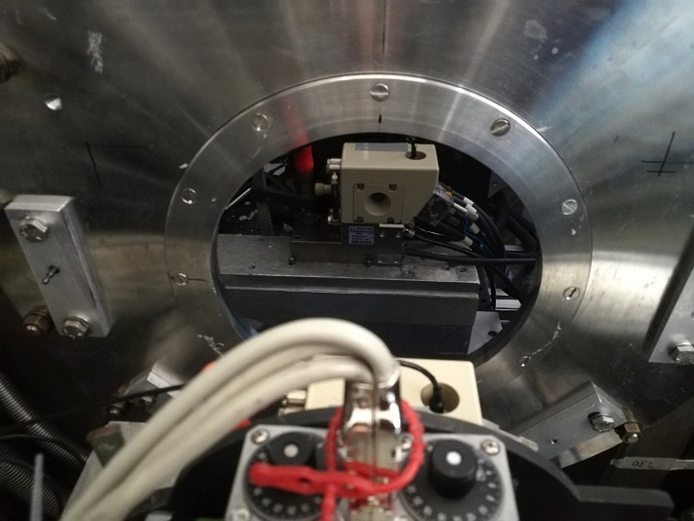
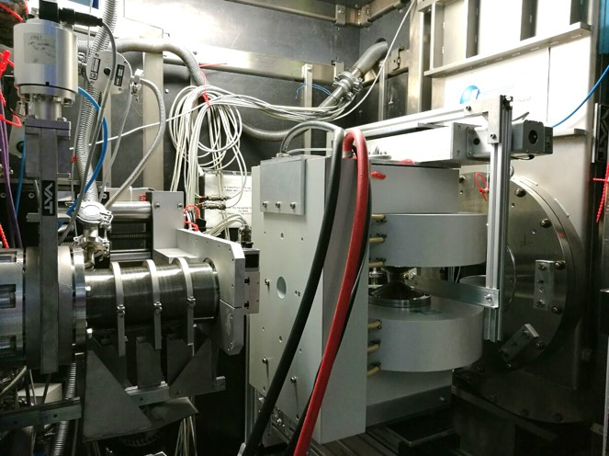
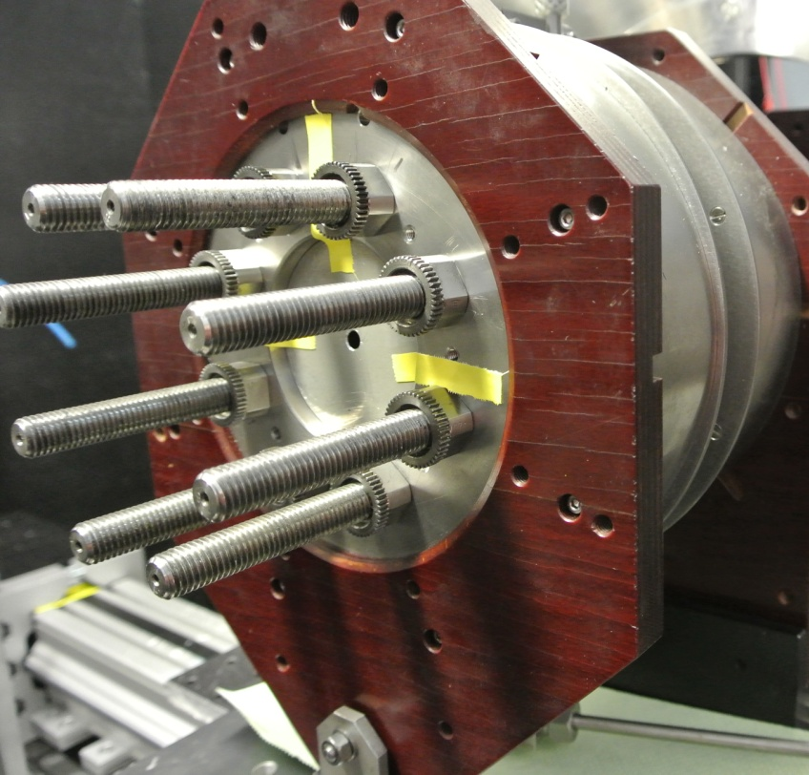
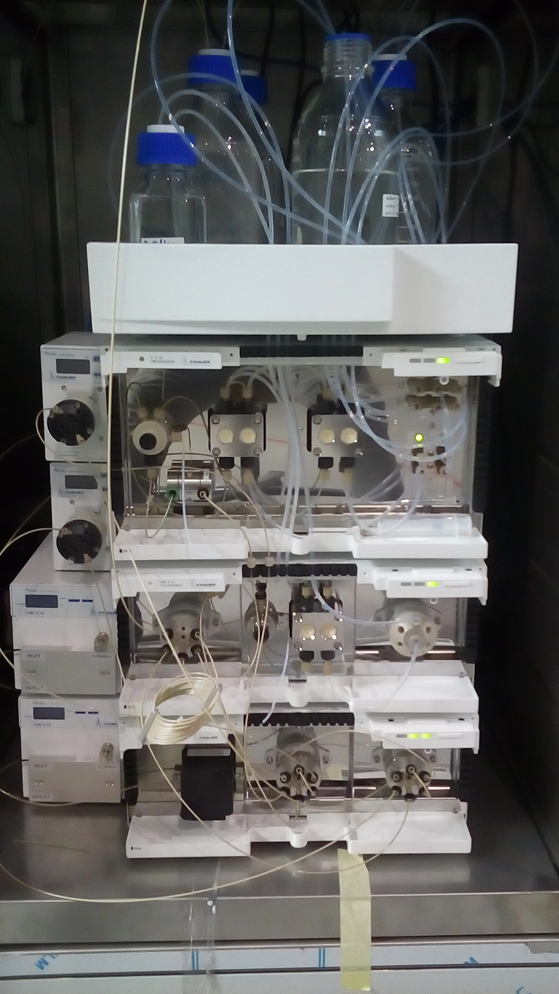
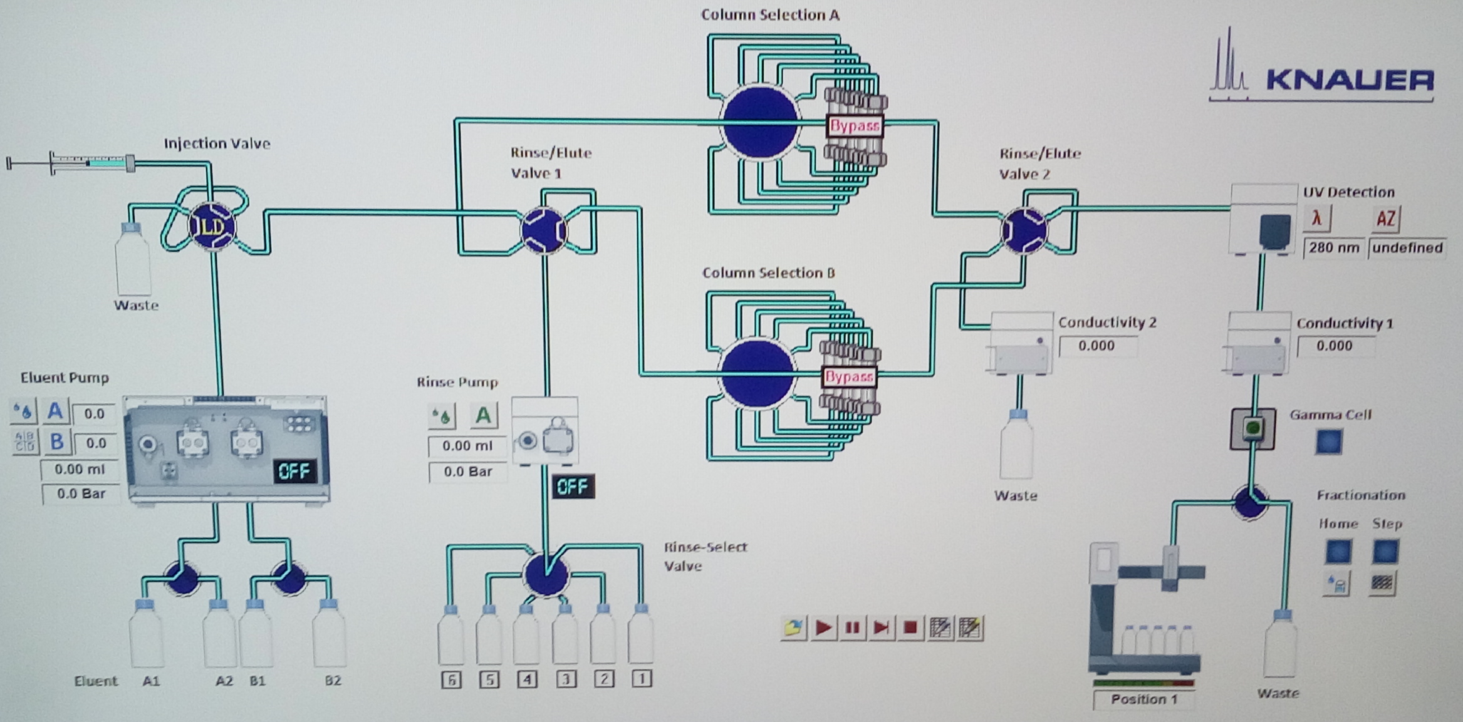
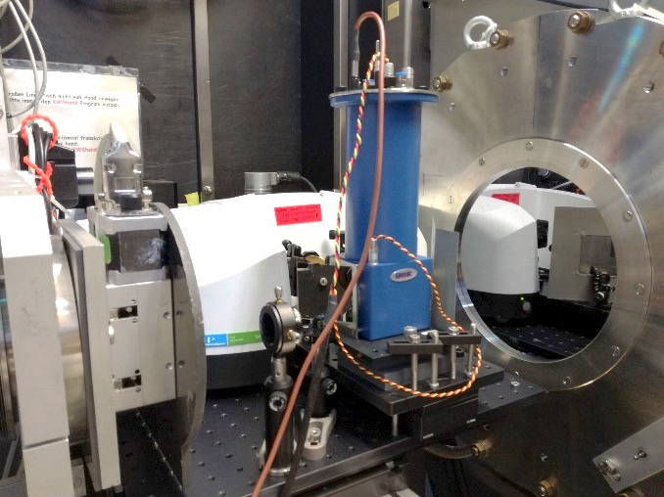
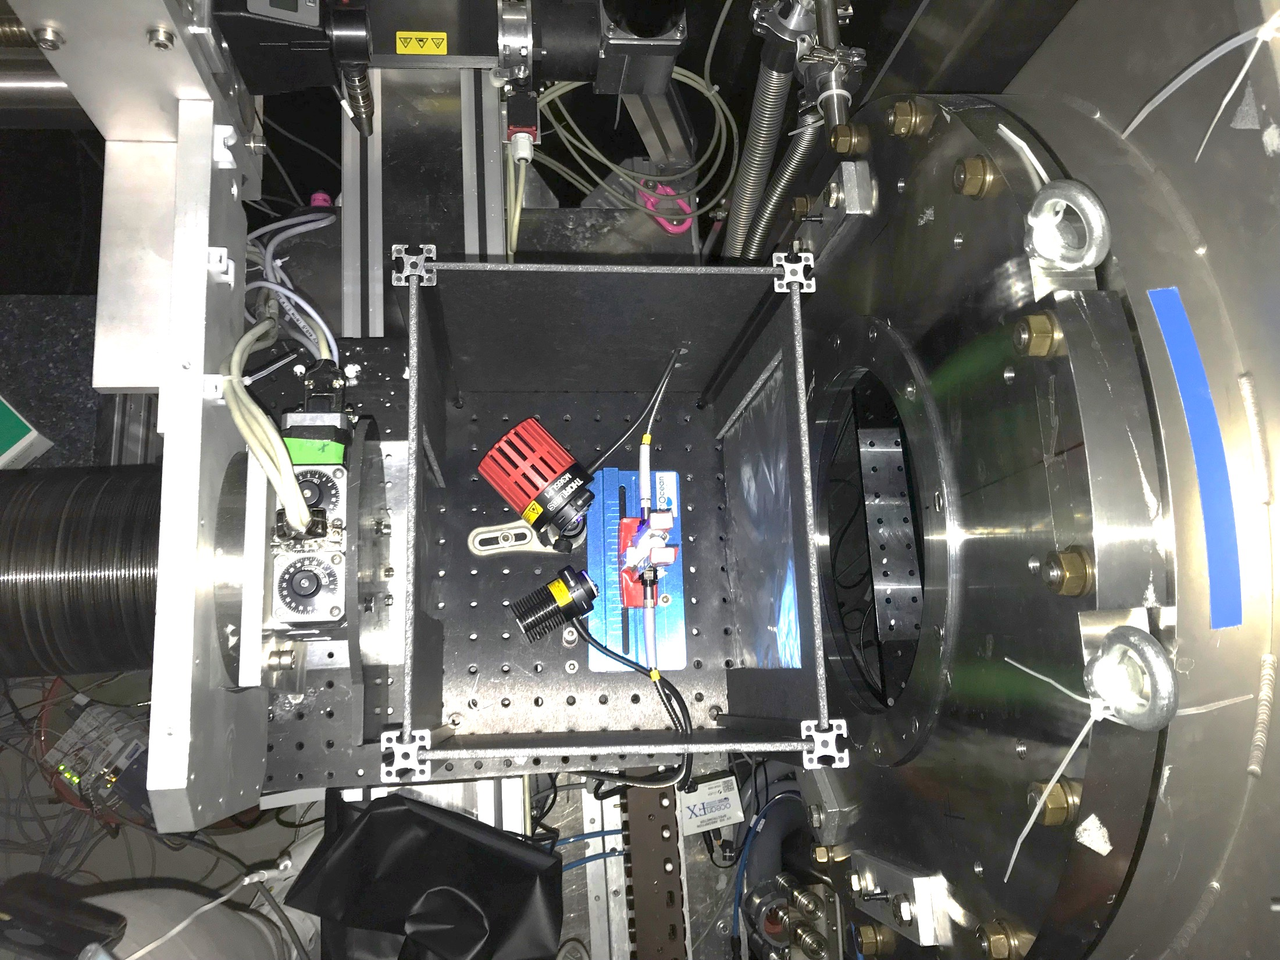
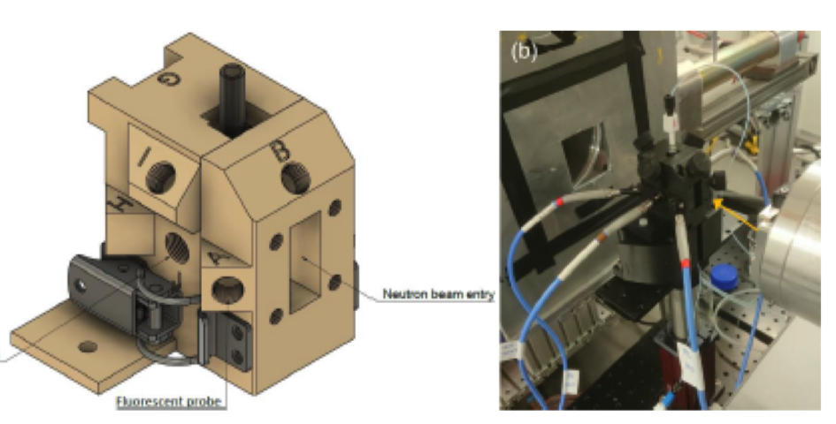
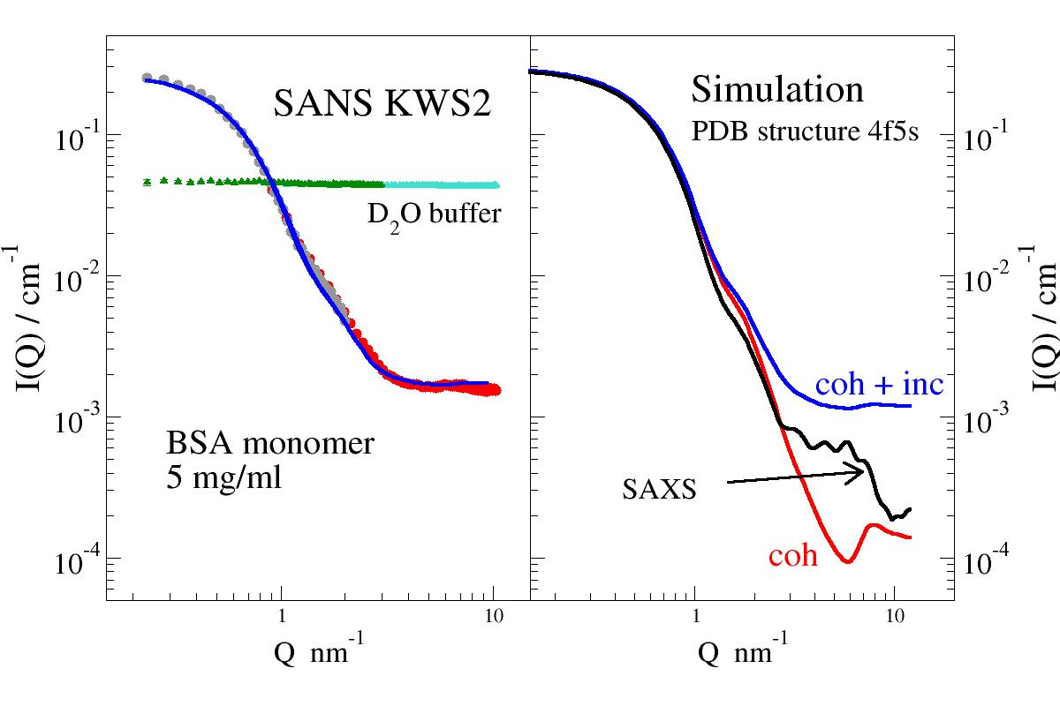
KWS-2 – the high intensity / wide Q-range SANS diffractometer
Aurel Radulescu, Christian Lang, Marie-Sousai Appavou
Jülich Centre for Neutron Science (JCNS) at MLZ, Forschungszentrum Jülich GmbH, Garching, Germany
Instrument Description
flux
Q-range
resolution
counting rate
conventional pinhole
high-intensity (focusing)
high-resolution (focusing)
TOF chopper 1 – resolution
TOF chopper 2 – separation inelastic-elastic
Sample Environment & In-situ Complementarities
Future Instrument Development
multi-detector array - WANS
shearing
fast mixing
stretching
low temperature
SEC–SANS
hydration
electromagnet
pressure
FT-IR
UV-Vis
Acknowledgement: G. Brandl – IT; S. Staringer, T. Kohnke, H. Feillbach, R. Hanslik (ZEA-1, FZJ) – Mechanics; E. Babcock & Z. Salhi – ³He; V. Ossovyi, S. Janaschcke & R. Möller – electronics; R. Engels & G. Kemmerling – detectors; A. Weber, D. Vujevic – sample environment; S. Polachowski, M. Leyendecker , T. Ortmanns, F. Müller (ZEA-1, FZJ) – Choppers;

